Slide 1
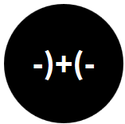
Opening the Black Box of Interaction in Visualization
Hans-Jörg Schulz¹, Tatiana v. Landesberger², Dominikus Baur³
VIS Tutorial 2014
D .MINIK.US
Fraunhofer IGD, Rostock, Germany
TU Darmstadt, Darmstadt, Germany
Dominikus Baur Interfacery

Slide 2
Part III: Interaction Metaphors and Guidelines
Speaker: Dominikus Baur

Slide 3
Part 3: Interaction metaphors




Activities: What the user does to trigger a change in the computer (Action)
Metaphor: What the user thinks the computer is doing and vice versa (Understanding)
Architecture: What the computer actually does (Reaction)
Notes:
we’ve arrived at the last part of the tutorial: interaction metaphors and guidelines. this is the overarching glue that ties everything together, the human-computer-system that encorporates both users and machines.

Slide 4
6Ws of Interaction
WHY do we interact?
WHAT is the purpose?
HOW do we interact?
WHO interacts?
WHEN do we interact?
WHERE is interaction used?
Effects and means
Context of interaction
[adapted from Roth13, Jansen et al 13]
Notes:
repetion from before – we’ve heard how we can classify the human-side of the interaction along the hierarchy of 6W, why, what, how and so on. these aspects come in two flavors, the direct interaction between the human and the machine and the context of the interaction. when creating interactive visualizations, the designer has quite a job ahead of her:

Slide 5
ENABLE
INTERACTIVE
DATA EXPLORATION
Notes:
first of all, we have to enable interactive exploration. but that is of course the bare minimum. it‘s kind of expected.
what‘s more important is to make these interactions as convenient as possible, pull all of the tricks that you can do using context and metaphors (we‘ll talk about that in a bit).
but much more important is to enable understanding and memorization! of the interface that is. you probably all remember a first experience with a new system that failed in this regard: you were wondering how to do something without a clue or any hints. such a situation usually leads to the universal help function: the Google search.
the second aspect, memorization, means how easy it is to remember how to do something once you‘ve pulled it off. again, you probably remember that time when you did something uncommon and tried to repeat it. memorization not only means how to

Slide 6
ENABLE
UNDERSTANDABLE
MEMORABLE
INTERACTIVE
DATA EXPLORATION
Notes:
first of all, we have to enable interactive exploration. but that is of course the bare minimum. it‘s kind of expected.
what‘s more important is to make these interactions as convenient as possible, pull all of the tricks that you can do using context and metaphors (we‘ll talk about that in a bit).
but much more important is to enable understanding and memorization! of the interface that is. you probably all remember a first experience with a new system that failed in this regard: you were wondering how to do something without a clue or any hints. such a situation usually leads to the universal help function: the Google search.
the second aspect, memorization, means how easy it is to remember how to do something once you‘ve pulled it off. again, you probably remember that time when you did something uncommon and tried to repeat it. being memorable means not only how easy it is to remember something, but also how easy it is to figure it out again, when you forgot it.
so this is basically what interaction design for visualization is about.

Slide 7
Notes:
interaction design is the design discipline concerned with designing interaction (duh). here‘s bill verplank explaining what that means and what questions to consider:

Slide 8
1_verplank-interaction-design.avi
Bill Verplank on Designinginteractions.com http://www.designinginteractions.com/interviews/BillVerplank

Slide 9
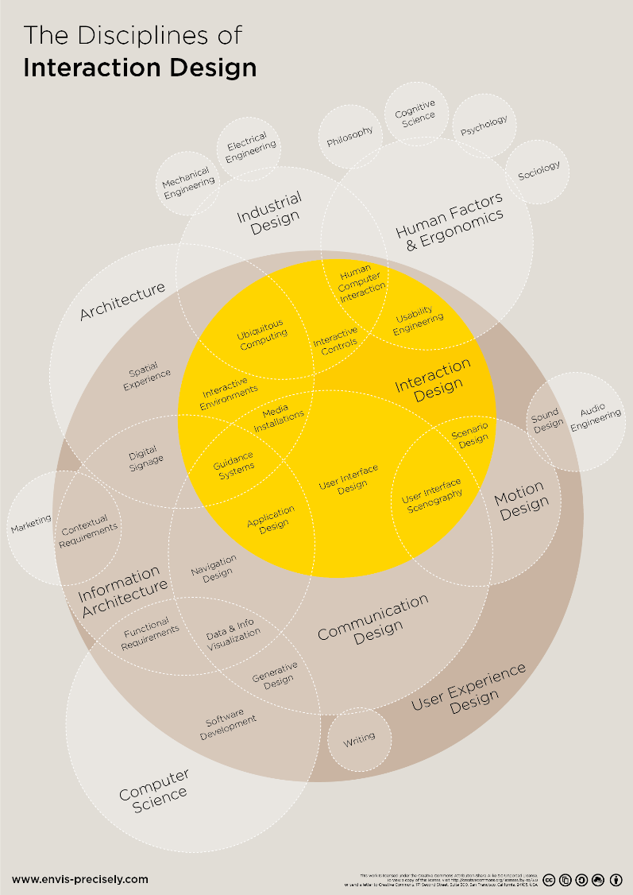
Interaction design
more of a craft than an (exact) science
heuristics-based
related/overlapping fields:
UXD (User Experience Design)
UID (User Interface Design)
Usability Engineering
...
http://visual.ly/disciplines-user-experience-design
Notes:
if you look into the interaction design discipline itself, you‘ll find a huge mess of varying terms and categories.

Slide 10
ENABLE
UNDERSTANDABLE
MEMORABLE
INTERACTIVE
DATA EXPLORATION
Notes:
so, thinking back to this here: how do we create this?
as i said, interaction design is a craft, so there‘s no absolute right or wrong – just different shades of wrong. it‘s all about trade-offs.
and while interaction designers have come up with various tricks to create good interfaces, it‘s still a craft – so unfortunately there‘s no algorithm to follow and it‘s a lot about experience. still, i‘ll try to give you a couple of hints about how to pull it off.

Slide 11
process
Notes:
first, we‘ll discuss the overall process of designing interactive visualizations. understanding what you‘re trying to design helps you in actually designing it. and before doing that you should be clear about a couple of things.

Slide 12
What are you designing?
Data exploration/analysis tool
Data presentation
(proof-of-concept for visualization technique)
Notes:
first question you should ask yourself is: what exactly are you designing? when it comes to visualization, there‘s a couple of patterns. you might design a data exploration/analysis tool, very classical. imagine something like Tableau or Gephi. the exploration is usually open-ended and it‘s not clear beforehand what exactly people are looking for or might find. so interaction is very important.
second option is a data presentation tool. examples are the interactives from the new york times website. in this scenario, you‘re already aware of the insights in the dataset and you want to make your audience aware of them. usually you let your audience explore the vis through interaction, but it‘s much more guided than in the previous scenario. your audience is basically just tagging along.
last case is special – more about showing the technique than the data. vis itself becomes focus of attention, no longer a tool.

Slide 13
Context
Audience (researchers, analysts, general public)
Platform (desktop, interactive surface, mobile)
Data (fixed dataset with known insights, fixed dataset, real-time data)
Notes:
once you know what you‘re designing, think about what you‘re designing FOR, i.e., in which context your design should work. most important aspect is the audience, of course. are you designing for researchers or analysts who are aware of the subject matter and kind of know what they are doing anyway? maybe they‘re even visualization experts? or are you designing for the general public, for example by building a web-based visualization that can be accessed from everywhere? by the way, if you‘re interested in web-based visualization, don‘t miss my other tutorial tomorrow afternoon – ‚everything except the chart‘!
second question is your target platform: maybe you‘re building a research prototype that only runs on desktop computers (and maybe even the ones that you control, for example for a study), so you have pretty tight control over your platform. you can also build visualizations for more experimental platforms, such as interactive tables and walls or virtual reality headsets. finally, there‘s also mobile, which gives you a completely new set of constraints (we‘ll talk about that later in more detail)). maybe you‘re even developing for the web, so you can‘t really be sure what type of computer, tablet or phone your users are using to access your visualization.
finally, a crucial question is the dataset. the underlying data makes or breaks a visualization. some visualization techniques work great with certain forms of data but completely fail with others. so, do you have a fixed dataset where you know the insights (as in the data presentation case from before), or maybe a fixed dataset that people are supposed to explore using your vis? or maybe even real-time data that changes depending on the time your visualization is used?

Slide 14
Goals
in-depth analysis
casual exploration
quick lookup
complexity
expressivity
Notes:
so, what do we ask all these questions for? what we want to identify are our users‘ tasks that they try to perform using your visualization.
and those goals can be completely different, depending on audience, platform, type of vis and so on. note that i‘m now talking about overarching, global goals, not specific tasks such as overview, filter, etc.
we can distinguish between three of these goals, that give you an idea of the complexity required in the visualization and interaction. this complexity increases from bottom to top, but at the same time, the expressivity of the visualization also increases. your in-depth-analysis tool lets you find much more interesting patterns in your data, than your (possibly mobile) quick lookup tool.

Slide 15
Data presentation architecture
basically: prioritize aspects of your data
which aspects to visualize how?
start with static representations (along visual variables)
additional info (details-on-demand) via interaction
Notes:
based on these goals, you can start creating your actual visualizations. this is a process that some people call ‚data presentation architecture‘, meaning: prioritizing the various aspects of your data and how you would display them. think back to the goals: if you have, for example, a quick mobile lookup tool you want to make sure that the relevant information is visible right after starting the visualization. say, the tool is for displaying a train map, then you should prioritize the user‘s current position and the way to their destination.
usually, you want to start from static visualizations based on this priorization and create them relying on your visual variables. these visualizations should already show as much of the info as possible. you can then use interaction to infuse your visualizations with more information in a classical details-on-demand fashion.

Slide 16
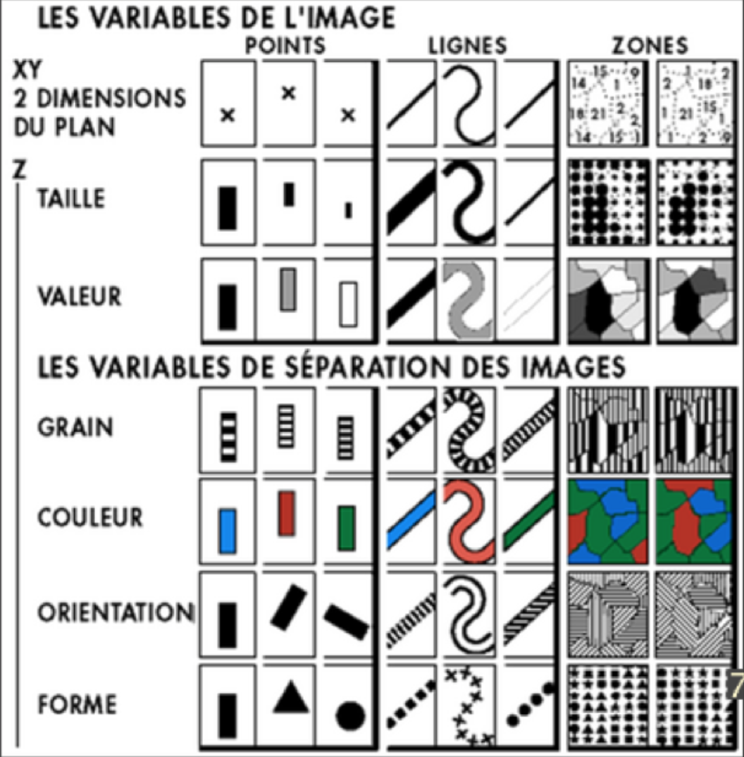
Visual variables
Notes:
to design the visualizations themselves, having a concept of how aspects of it are perceived is very helpful. jacques bertin originated this concept of visual variables, separating the various visual attributes along a hierarchy of importance. i won‘t go into details here, since most of you probably know this concept, so just a quick overview: bertin separated visual information into points, lines and areas and categorized them along: position, size, brightness, texture, color, orientation and shape. the further up a variable stands, the easier and more reliably it is to perceive.
so, these variables should coincide with your prioritization from before, mapping the most important aspects to position, less important ones to shape and so on (of course, that always depends on what your visualization actually displays and if a variable actually exists).

Slide 17
Visual encoding
depends on your data
iterative process
can be intertwined with or preceeded by interaction
Notes:
using this prioritization and visual variables then leads to some type of visual encoding, depending on your chart etc.
every visualization designer knows the point in their process when they‘ve decided on a visual encoding, did some prototyping maybe in tableau or even in code, and see the actual data in their actual visualization for the first. and this is usually also the point where you have to decide on a new technique or at least tweak your existing one for the first time, since data-infused visualizations always look different from the original sketches! so the visual encoding is an iterative process, where you have to constantly check if your data fits your visualization.
visual encoding can also be intertwined with the interaction design. some visualizations don‘t make much sense without a corresponding interaction, for example, when you‘re displaying no labels on your bubble chart or scatterplot due to space constraints and show them interactively or if some initial interaction is required to select a specific view out of a couple of options (this is the case in excel or tableau, for example, where you‘re initially getting a simple spreadsheet and have to select a visualization technique before actually getting to see anything).

Slide 18
Interaction
see various models from part 1
based on goals and context
for existing techniques: use learned interactions
for novel techniques/platforms: use learned interactions from the platform
Notes:
then, finally, we arrive at the interaction. as i said, sometimes interaction design coincides with the visualization design, if a visualization technique doesn‘t make much sense without the corresponding interaction. these interactions are based on the goals (again) and the interaction context, for example, the platform that people are using the visualization on.
here it‘s also important to rely on learned interactions. for example: if you have a scatterplot and people want to access additional information about a point in the visualization, they will probably try to hover above it using the mouse first. so, don‘t try to be clever and do something unexpected there. if you‘re relying on an existing visualization technique, also rely on the learned interactions that come with it. otherwise, you will only confuse and frustrate people.
if you‘re using a completely novel visualization technique, you can of course come up with whatever interaction you like. this also goes for an existing visualization technique on a novel platform. still, try to rely on learned interaction from the corresponding platform. say you build scatterplots for smartphones: you probably all know the two-finger-pinching-gesture. this is a learned interaction for the platform. so, people will try to use that on your visualization to enlarge it. let them.

Slide 19
2_touchwave.avi
Notes:
here‘s an example for putting an existing visualization technique on a new platform. touchwave ...

Slide 20
Interaction scale
Navigation (select view type)
Filtering/Highlighting (select perspectives on the data)
Microinteractions (details-on-demand)
Notes:
finally, when you‘re thinking about the actual interaction, again, think back to the models from the first part of the tutorial, but a rough organization: high-level stuff (navigation), medium-interaction (filtering/searching/highlighting) or low-level, quick interactions (microinteractions)

Slide 21
GOAL
Visual
Representation /
Encoding
Data
Presentation
Architecture
Interaction
METAPHOR
Notes:
conceptual overview of the datavis design process. the goal informs the actual process, that‘s cyclical...
task (in this case: audience, context, etc) is informing the cycle of DPA that leads to representation and available interaction.
we‘ll talk about metaphor in a bit.

Slide 22
HEURISTICS
Notes:
first: as with every craft, there‘s a long long list of heuristics for interaction design...

Slide 23
HCI “Laws”
Fitts’ Law (Paul Fitts 1954)
Hick’s Law (William Edmund Hick 1952
Teslers’ Law (Larry Tesler 1984
Notes:
Fitts’ Law (Paul Fitts 1954) - The larger the target, the faster it can be pointed to. Likewise, the closer the target, the faster it can be pointed to.
Hick’s Law (William Edmund Hick 1952) - The time it takes for users to make decisions is determined by the number of possible choices they have.
Teslers’ Law (Larry Tesler 1984) - Some complexity is inherent to every process. There is a point beyond which you can’t simplify a process any further; you can only move the inherent complexity from one place to another.

Slide 24
Heuristics examples:
Shneiderman: 8 golden rules
Nielsen: 10 Usability Heuristics
...

Slide 25
8 golden rules
Strive for consistency.
Enable frequent users to use shortcuts.
Offer informative feedback.
Design dialog to yield closure.
Offer simple error handling.
Permit easy reversal of actions.
Support internal locus of control.
Reduce short-term memory load.
Notes:
just a brief overview ...

Slide 26
Elmqvist et al.: Fluid Interaction
DG1: Use smooth animated transitions between states
DG2: Provide immediate visual feedback on interaction
DG3: Minimize indirection in the interface
DG4: Integrate user interface components in the visual representation
DG5: Reward interaction
DG6: Ensure that interaction ‚never ends‘
DG7: Reinforce a clear conceptual model
DG8: Avoid explicit mode changes
[Elmqvist et al. 2011]
Notes:
something more specific about visualization: fluid interaction

Slide 27
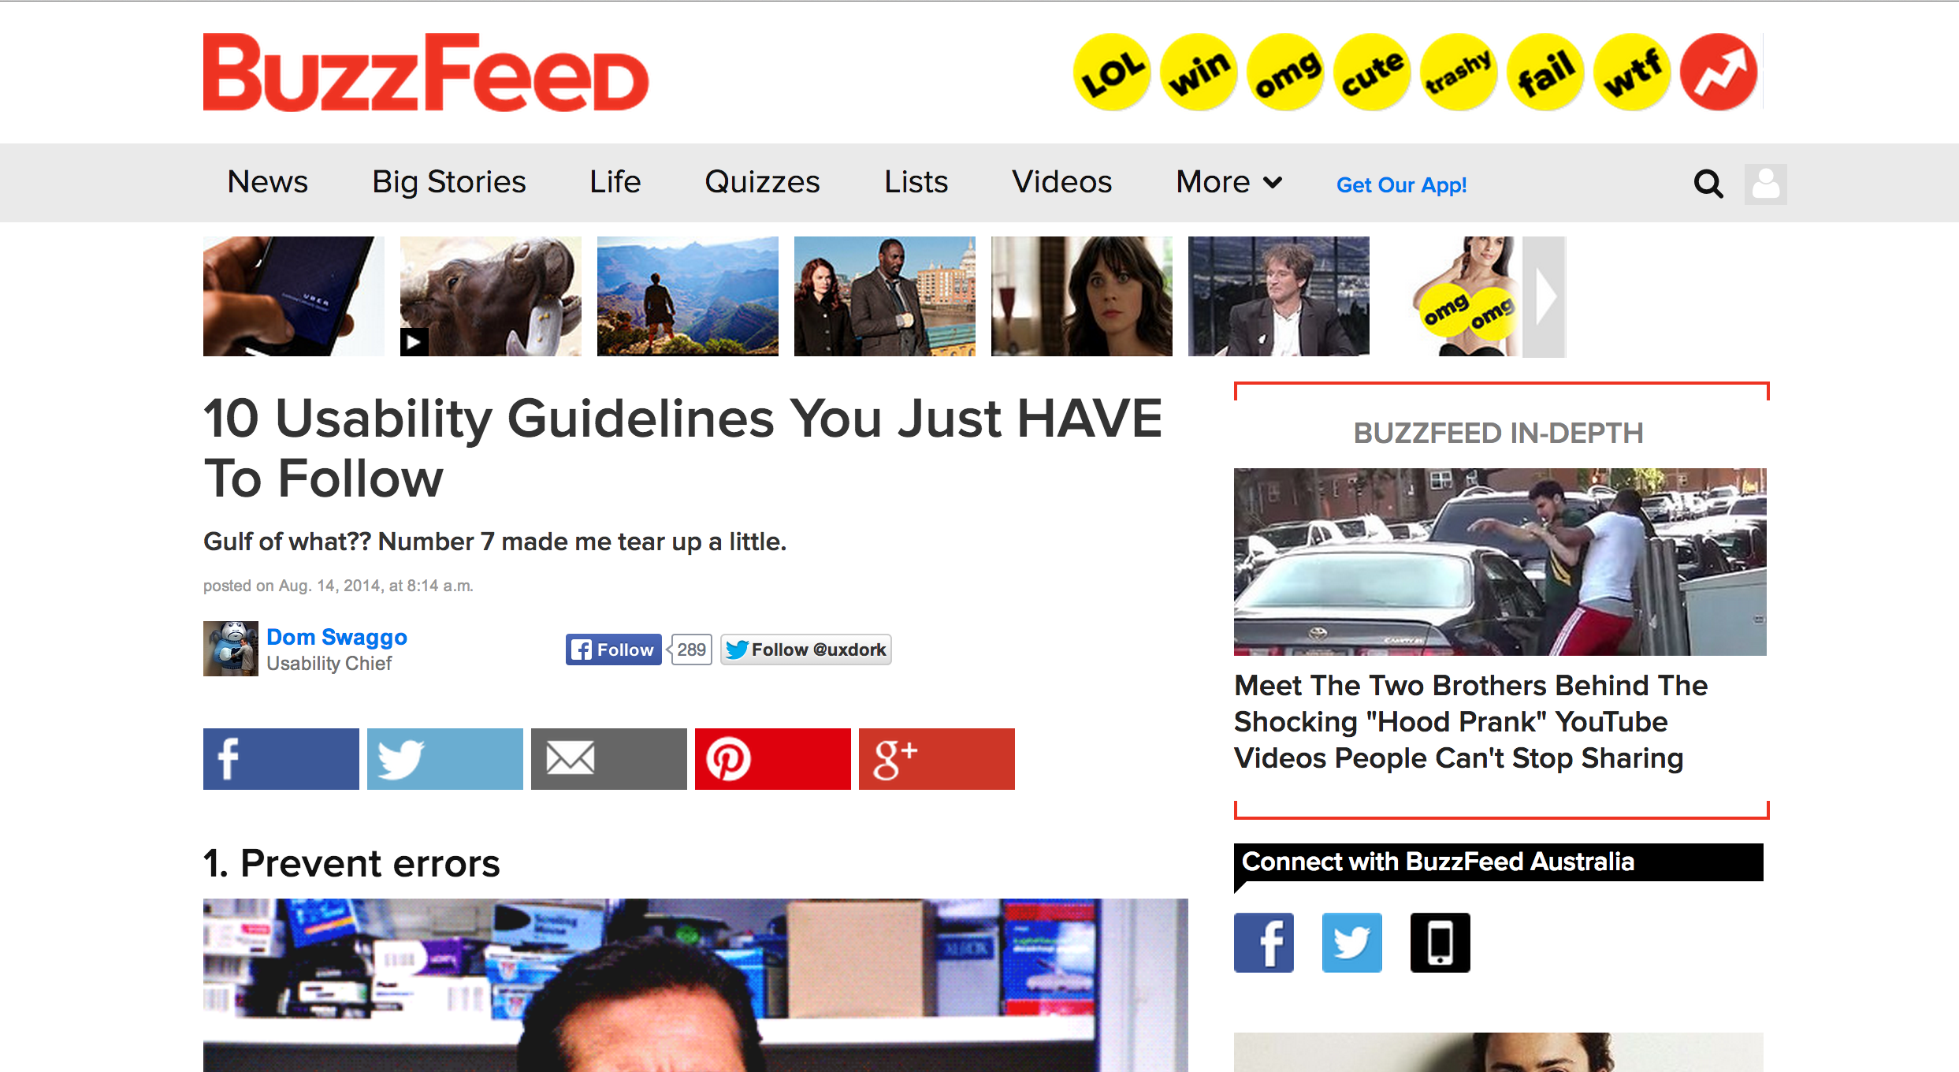
Notes:
sometimes heuristics read a bit like these things...

Slide 28
Heuristics
Absolute minimum of interaction design
Usually tells you what NOT to do!
Works well as checklist
Can be used for evaluation

Slide 29
Metaphors
Notes:
what‘s more useful are metaphors

Slide 30
„The essence of metaphor is understanding and experiencing one kind of thing in terms of another.“
Lakoff & Johnson: Metaphors We Live By
Notes:
what‘s a metaphor?

Slide 31
Metaphors
in IxD: mental model that both designers and users adhere to
users can rely on knowledge about how one thing works to operate the other
shortcut towards understanding and memorizing and interface

Slide 32
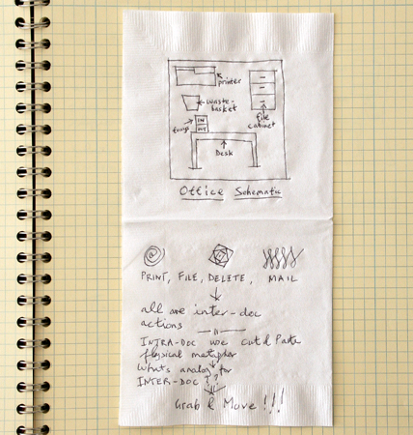
Metaphor example: desktop
Notes:
probably the most well-known example of a metaphor

Slide 33
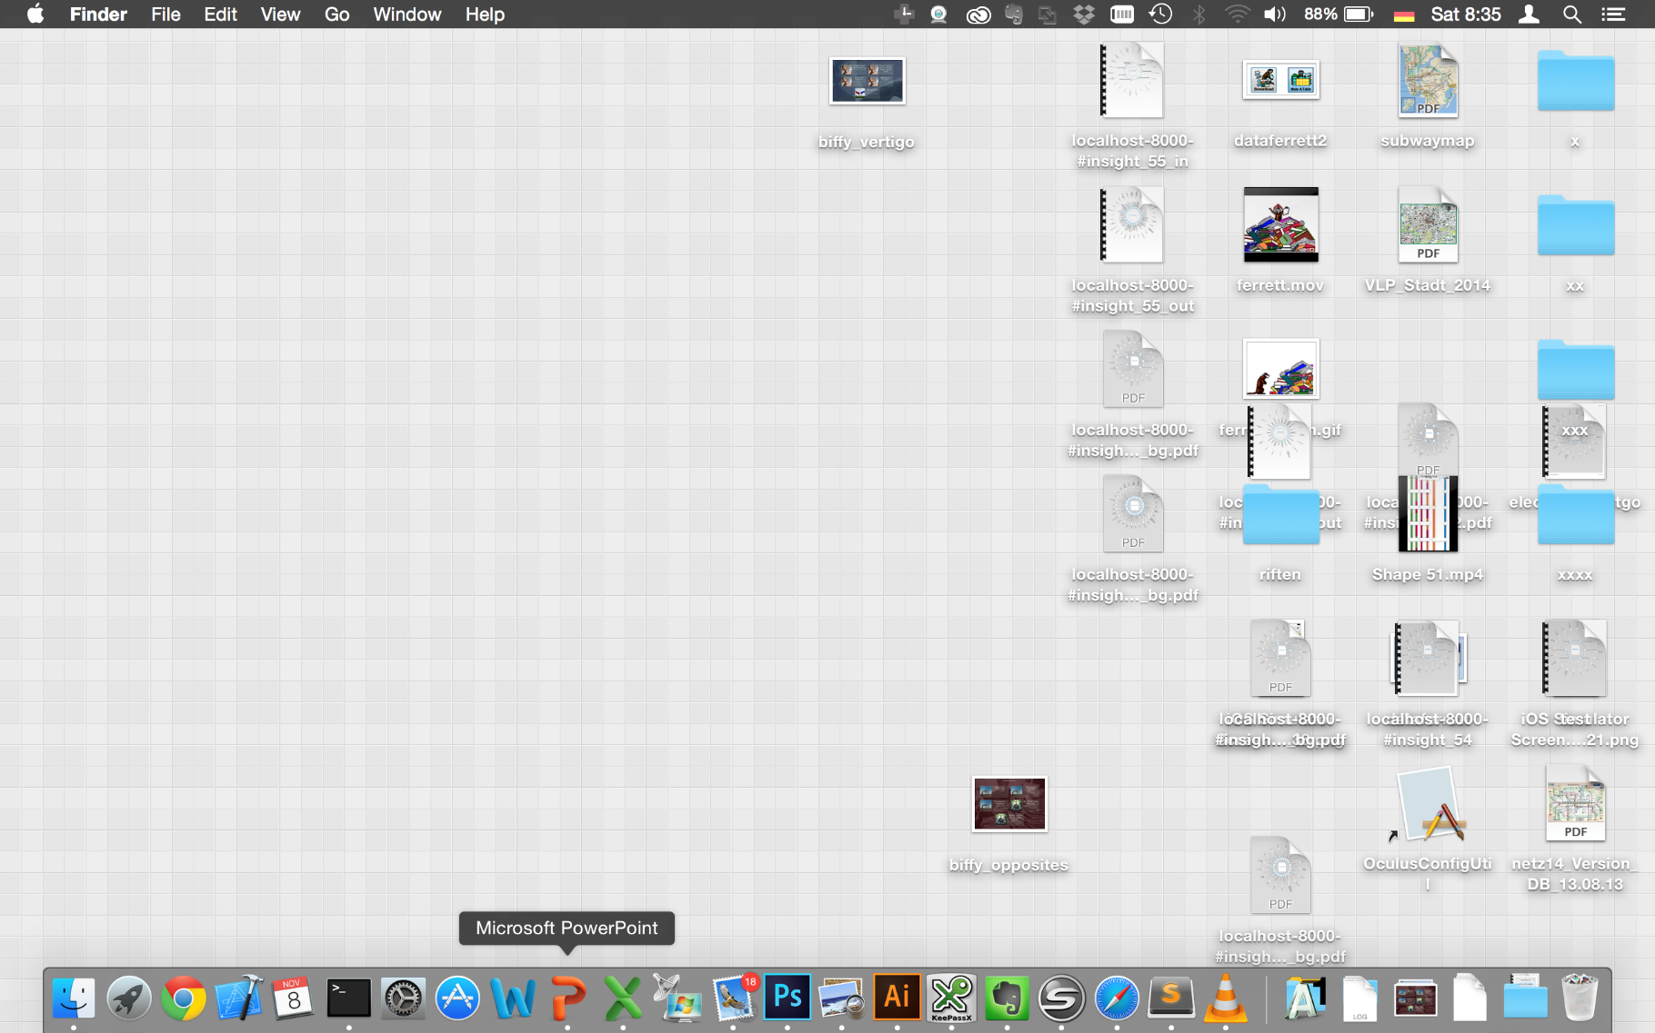
Metaphor example: desktop

Slide 34
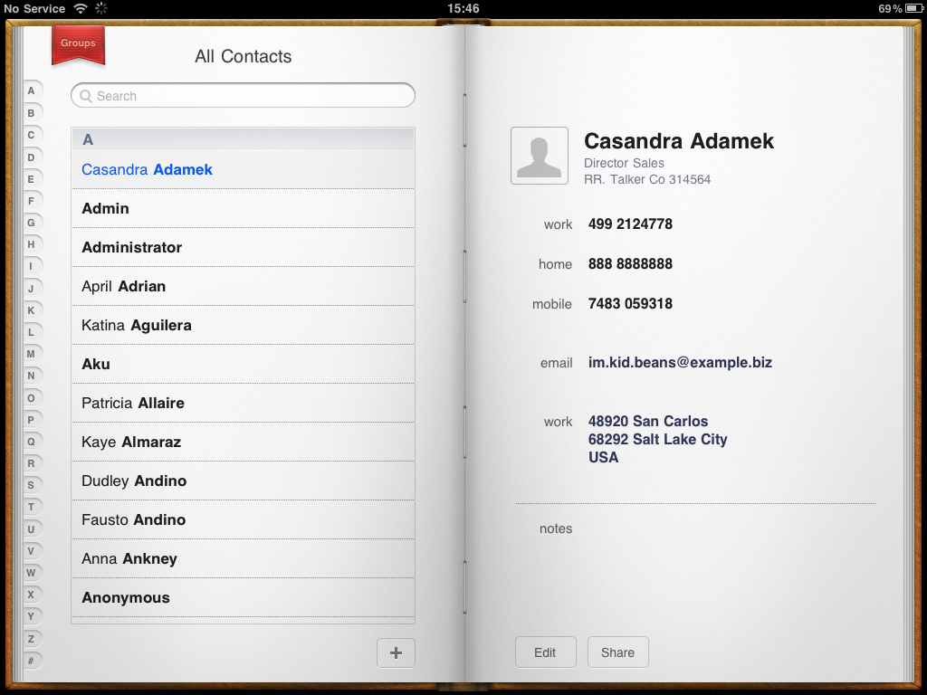
Notes:
metaphors can also go wrong...

Slide 35
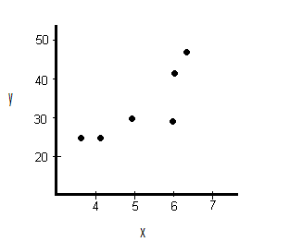
Metaphors in visualization?
Notes:
now, how does the concept of metaphors work in visualization? visualizations are pretty abstract things, how would we map existing stuff to them?

Slide 36
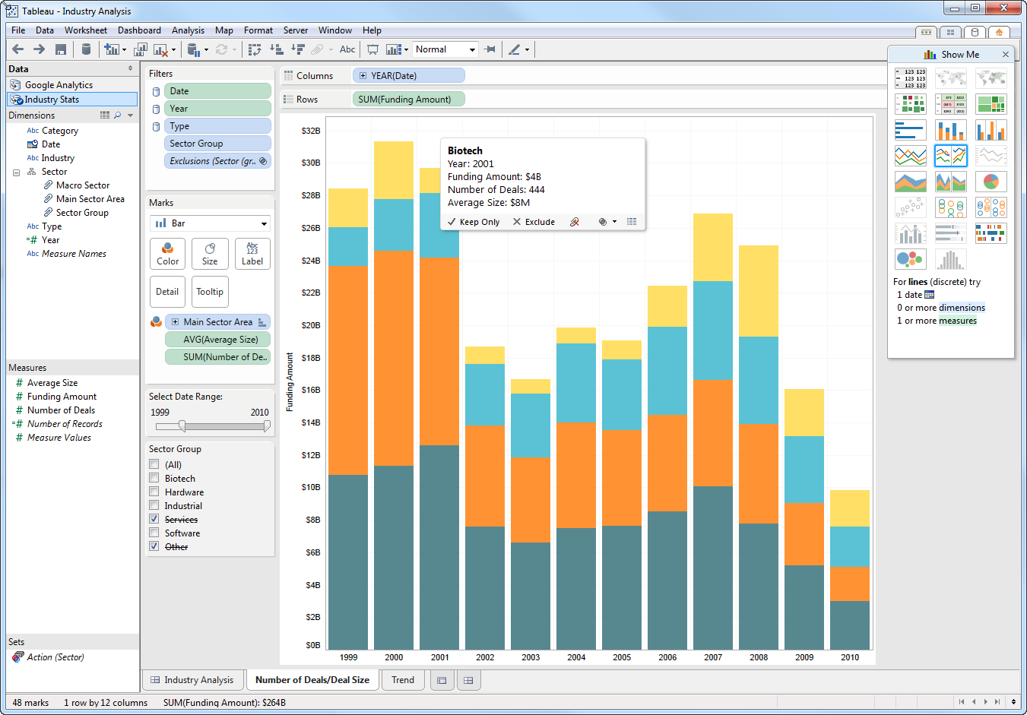
Notes:
1. basically, everything surrounding the visualization is based on metaphors: buttons, sliders, regular desktop widgets

Slide 37
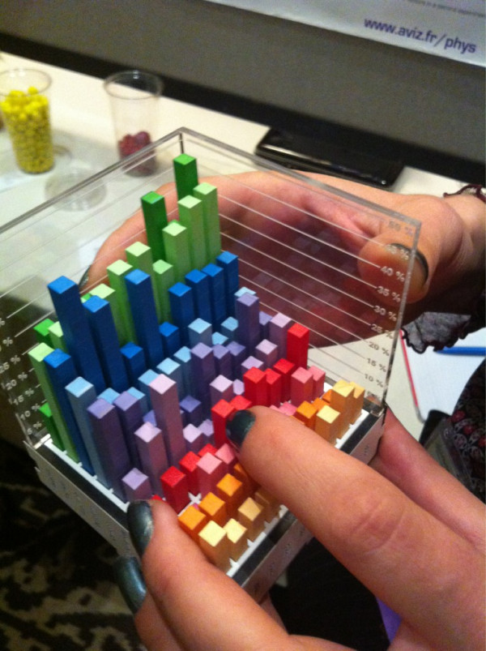
Visualizations as physical objects
http://twitpic.com/b53yc8/full
Notes:
another way for metaphor in visualization: visualizations as pseudo-physical objects.

Slide 38
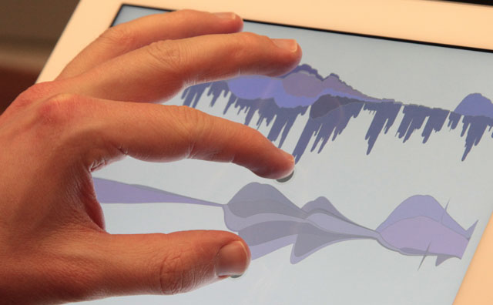
Visualizations as physical objects:
Notes:
another way for metaphor in visualization: visualizations as pseudo-physical objects.

Slide 39
Heider-Simmel Illusion
3_heider-simmel.mp4
Notes:
visualizations automatically become metaphorically loaded, especially animated/interactive ones, see also http://arxiv.org/pdf/0809.0884.pdf

Slide 40
4_metaphor-physical.avi
Notes:
metaphors heavily influence mobile interaction design

Slide 41
5_metaphor-orientation-evernote.avi

Slide 42
6_metaphor-orientation-facebook.avi

Slide 43
7_fun-facebook-messages.avi

Slide 44
Metaphors: Benefits & caveats
Pro:
clear entry point
solves problems of discoverability and orientation
Con:
too strict adherence, lose benefits of digital medium
users expectations are created by metaphor

Slide 45
GOAL
Visual
Representation /
Encoding
Data
Presentation
Architecture
Interaction
METAPHOR
Notes:
and this is metaphor in the context of our interaction design process. everything should be built on metaphor.

Slide 46
CONTEXT

Slide 47
Context
Explicit
Interaction
Notes:
usually: you want to have context as a type of implicit interaction. context is everything that happens around and even in the user while she or he interacts. so, for the interaction designer, it‘s a good idea to be aware of the role of context and also make use of it!
in the following: some types of context you can use

Slide 48
Context
Audience (researchers, analysts, general public)
Platform (desktop, interactive surface, mobile)
Data (fixed dataset with known insights, fixed dataset, real-time data)
Notes:
pulling back to a slide from before: there are several contextual aspects that you should be aware of, such as your audience, what platform you‘re developing for and what data you have. but wait, there‘s more!

Slide 49
Dynamic context: sensors
more and more sensors in computers and phones
intricate, real-time, super-human data
especially useful for start-up
Notes:
number of sensors is growing
super-human data: especially with quantified self: things like heart rate, steps taken, upcoming: stress, mood
using the dynamic context is especially nice for startup: launch map centered on position of user etc.

Slide 50
Trivial dynamic context
time of day
day of week/month
Notes:
trivial context is of course the audience and the platform. but also things that pretty much every platform supports:
such as taking the current time and date and use it to adjust the visualization (e.g., on a train map: hide lines that don‘t leave at the moment) – time can be very powerful

Slide 51
Dynamic context: geolocation
second-most important dimension after time
implemented in more or less every device
works well in tandem with compass
Notes:
implemented in more or less every device: non-GPS devices usually use WIFI for geolocation

Slide 52
Dynamic context: Others
Camera
Microphone
Touch
Device orientation
Bio-sensors
Notes:
device orientation: how to display vis
bio-sensors: heart-rate, steps, ...

Slide 53
Example for one specific device context: Mobile/touch interaction

Slide 54
Mobile interaction in a nutshell:
8_mobile-interaction-nutshell.mp4

Slide 55
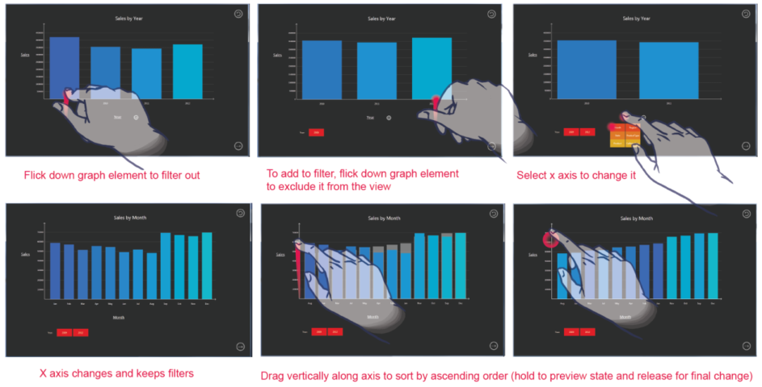
[Drucker et al.: TouchViz 2013]
Notes:
in a recent study drucker and colleagues from microsoft research have compared two bar chart visualizations for tablets, one mainly controlled by gestures and the other using a regular good old button control panel. and the results of the study showed that not only people preferred the gesture-controlled version, but that even their task performance was higher with gestures instead of buttons.

Slide 56
9_touch-scatterplots.mp4
[Sadana et al.: AVI 2014]

Slide 57
10_point-it.avi
[Sultanum et al.: ITS 2011]
Notes:
point it, split it, peel it, ...

Slide 58
Ergonomics
43px
44px / 88px
30px – 50px
43px
44px / 88px
30px – 50px
Nokia
Apple
Microsoft
Notes:
most important ergonomical consideration: size of touch elements.... most laptop interfaces just wouldn‘t work on touch

Slide 59
Ergonomics II
Notes:
other aspect: how is the device held?

Slide 60
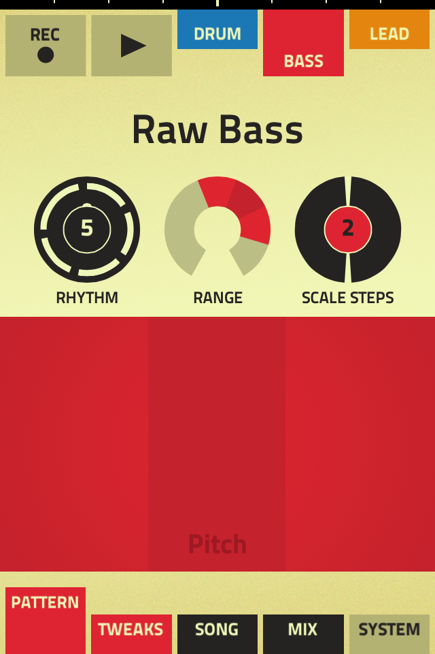
Discoverability
App: „FIGURE“

Slide 61
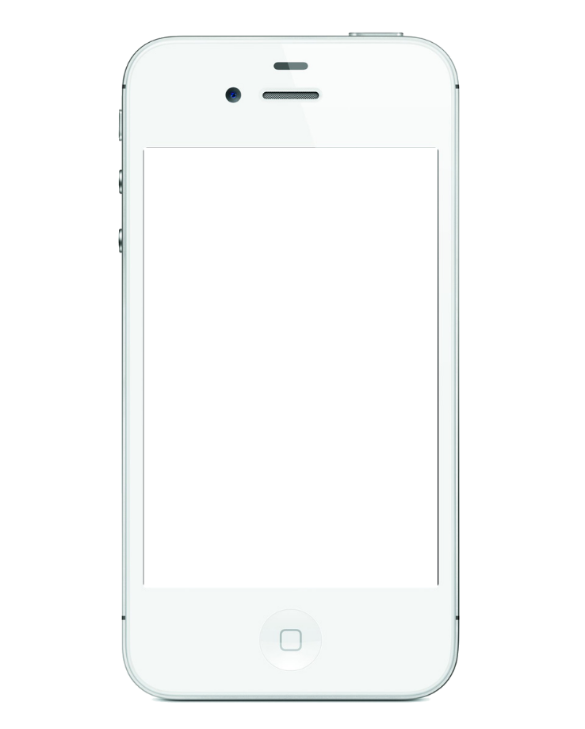
Learned interactions/conventions
Notes:
if i asked you to enlarge this photo, you‘d probably do ...?

Slide 63
Touch/mobile devices
ergonomics
context (social, environmental)
discoverability
learned interaction/conventions
fun!

Slide 64
GOAL
Visual
Representation /
Encoding
Data
Presentation
Architecture
Interaction
METAPHOR
Notes:
to sum up: think about who you‘re designing for, what person, what platform and what data. what goals your users have. then enter the cycle of coming up with the data presentation architecture, the visual representation/encoding and the interaction. ground everything on a useful, suitable metaphor.

