Slide 1
Grooming the Hairball - How to Tidy up Network Visualizations?
Hans-Jörg Schulz¹, Christophe Hurter²
VIS Tutorial 2013
University of Rostock, Rostock, Germany
Ecole Nationale de l’Aviation Civile, Toulouse, France

Slide 2
Part III: APPLICATIONS & OPEN RESEARCH QUESTIONS
Speakers: Hans-Jörg Schulz & Christophe Hurter

Slide 3
Applications
Visualizing the DBLP dataset (914,492 nodes / 3,802,317 edges / 22 time points)
Visualizing flight routes (34,550 nodes / 17,275 edges)
Software engineering Visualization (13,856 nodes / 48,591 edges)
Visualizing eye tracking data (5,000 nodes / 2,500 edges)

Slide 4
Visualizing the DBLP dataset (914,492 nodes / 3,802,317 edges / 22 time points)
Abello2014 - Modular DOI Function.avi

Slide 5
FromDaDy: Spreading Aircraft Trajectories Across Views to Support Iterative Queries
Christophe Hurter, Benjamin Tissoires, Stephane Conversy,
IEEE Transactions on Visualization and Computer Graphics 15, 6 (November 2009), 1017-1024.
Infovis 2009
Notes:
Hierarchical Edge Bundling (HEB) bundles edges together
by bending each edge, modeled as a B-spline curve,
toward the polyline path defined by the available hierarchy
[Hol06]. This method is not applicable to general graphs,
since it requires a graph to contain a hierarchy.

Slide 6
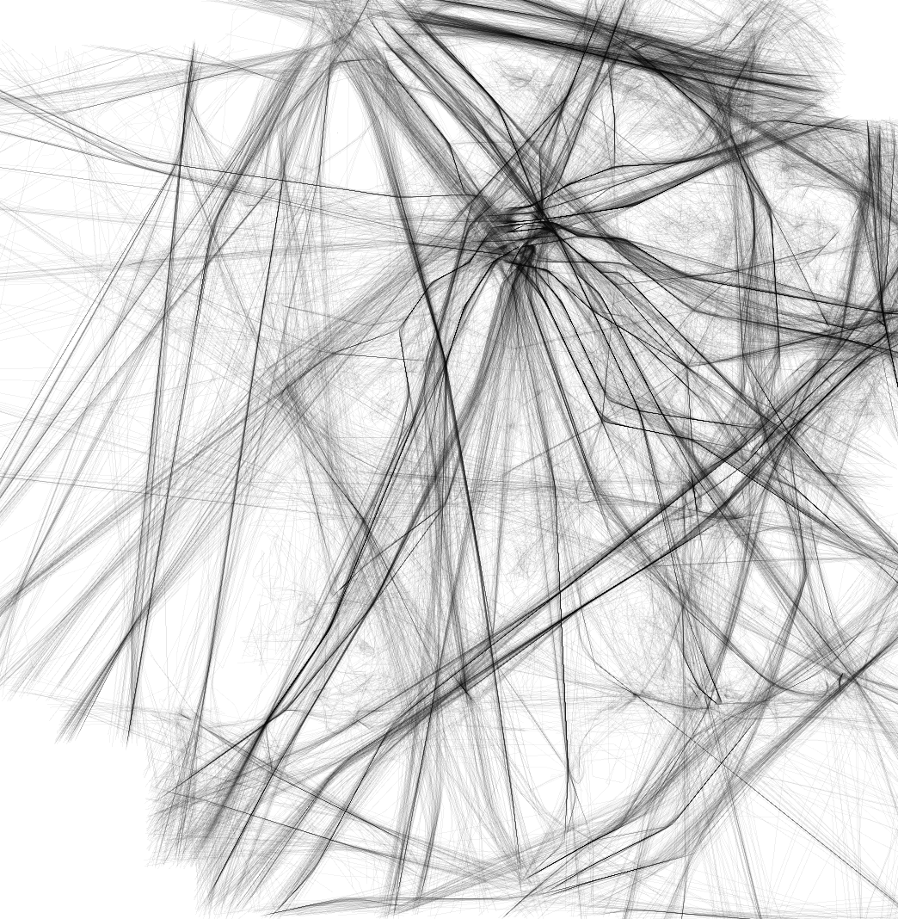
[Hurter et al. Infovis 2009]
Notes:
Currently ATC experts use the « Chevelu » visualisation , to describe dense trangled aircraft trajectories.
chevelu , in french, means a mass of hair on somebody’s head!

Slide 7
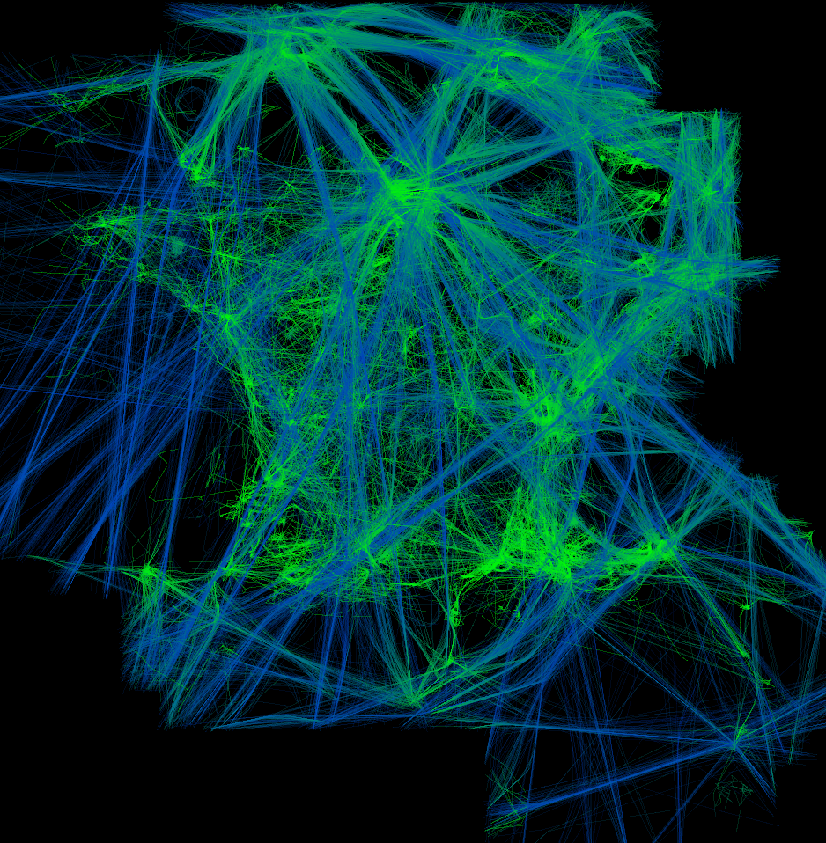
[Hurter et al. Infovis 2009]

Slide 8
Demo

Slide 9
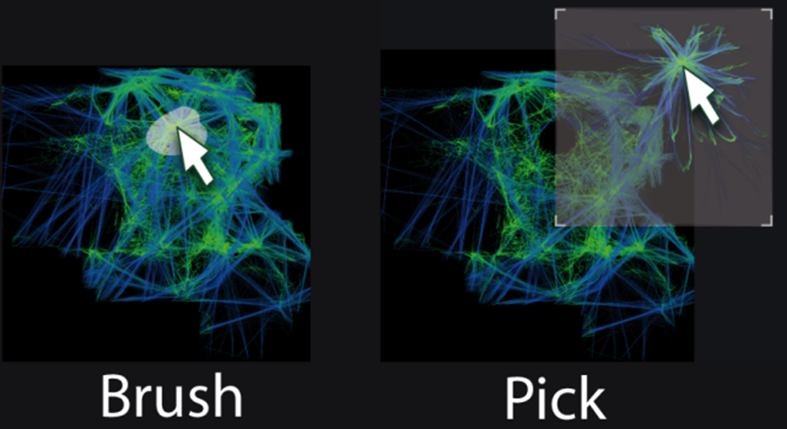
Exploration of large datasets
Design exploration
Interaction paradigms
[Hurter et al. Infovis 2009]
Notes:
> - 1 slide for the tool (**max 30sec**)

Slide 10
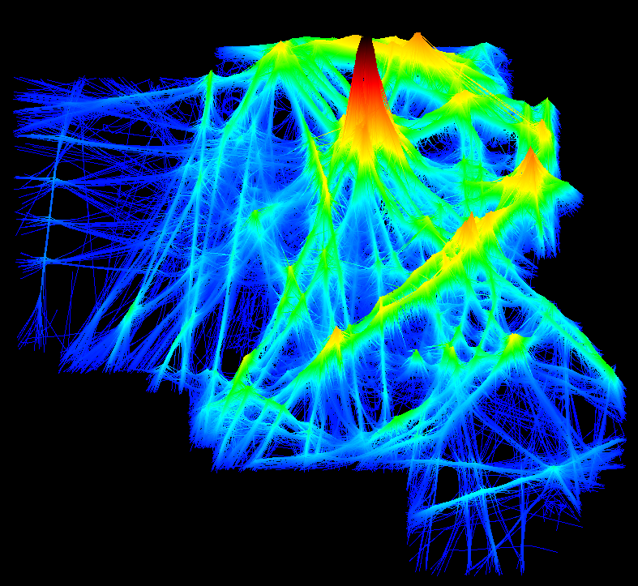
[Hurter et al. Infovis 2009]
Notes:
> - 2 to 5 remaining slides on the impact of the tool (**at least
> 1min**). WHAT has your tool contributed in the real world. WHO was
> impacted and in WHICH way?
We can provide a more « user-friendly » design to emphasize the nature of the information embedded in such datasets.
Which are self explanatory.
Please visit my post if you want to learn more about the exploitation of such view.

Slide 11
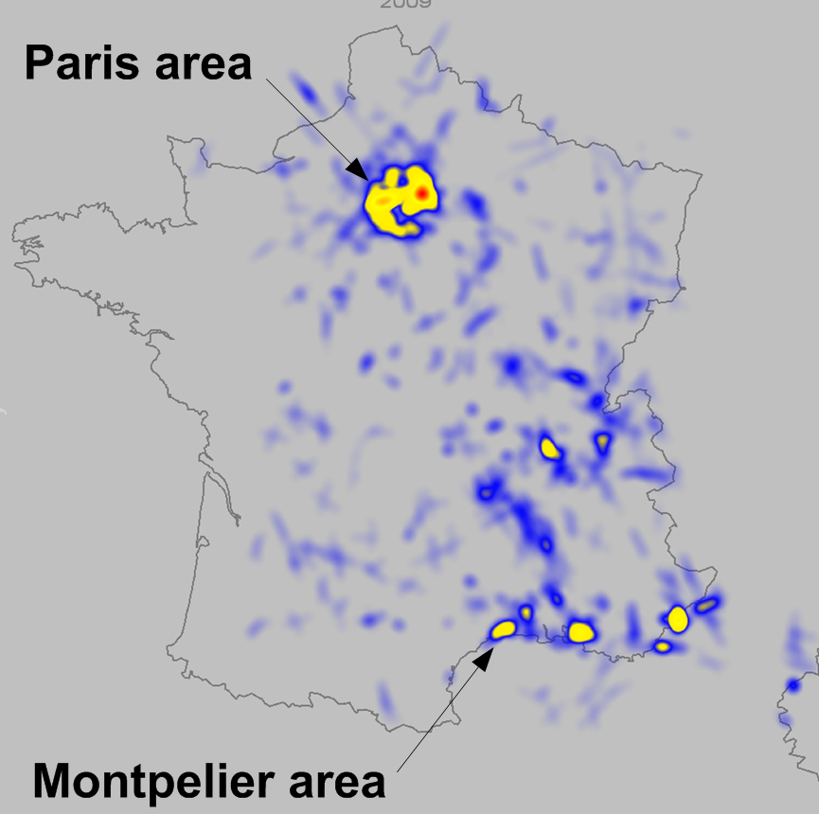
Improving safety
Accumulation map of aircraft proximity alarm (TCAS).
Notes:
> - 2 to 5 remaining slides on the impact of the tool (**at least
> 1min**). WHAT has your tool contributed in the real world. WHO was
> impacted and in WHICH way?

Slide 12
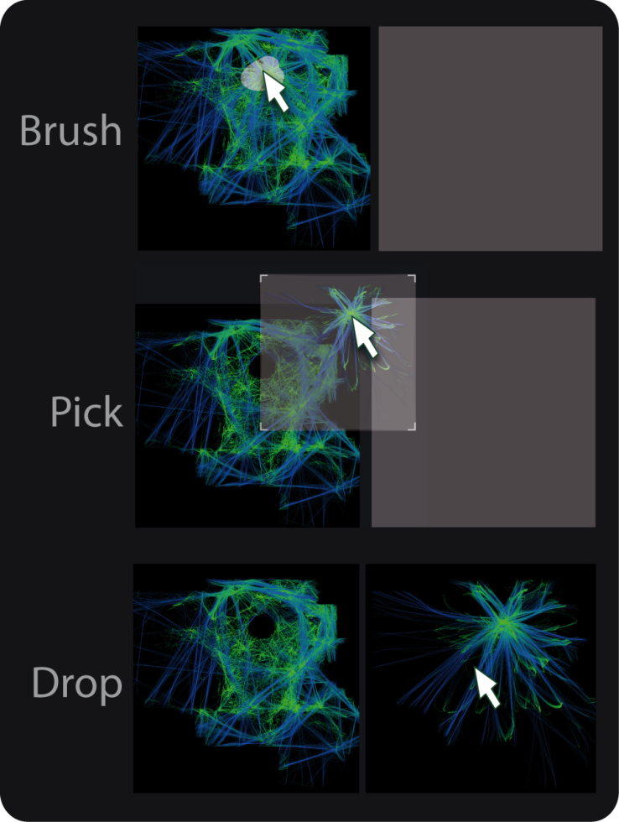
FromDaDy features
Visual configuration tool
Brushing and incremental selection
Pick and drop
A matrix of juxtaposed views
Spreading trajectories across views

Slide 13
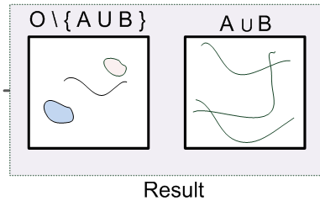
Boolean operations
Example: union operation

Slide 14
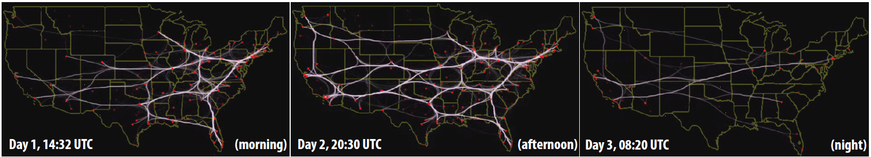
Bundled Visualization of Dynamic Graph and Trail Data
C. Hurter, O.Ersoy, S.I. Fabrikant, T.R. Klein, A. C. Telea TVCG 2013
Notes:
Hierarchical Edge Bundling (HEB) bundles edges together
by bending each edge, modeled as a B-spline curve,
toward the polyline path defined by the available hierarchy
[Hol06]. This method is not applicable to general graphs,
since it requires a graph to contain a hierarchy.

Slide 15
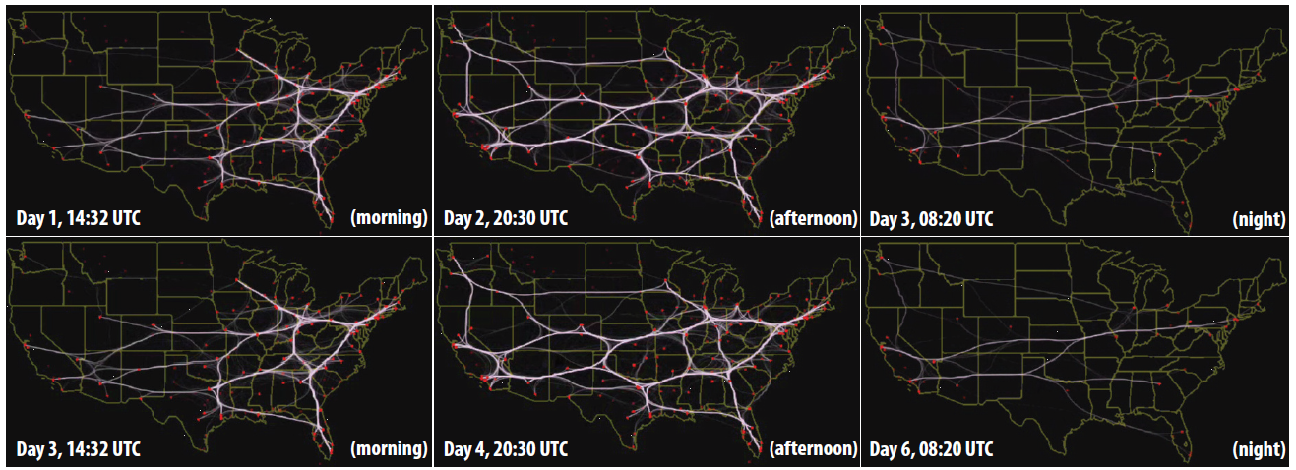
Streaming graph 6 weeks US flight
Streaming visualization for 6-days US airline flight dataset

Slide 16
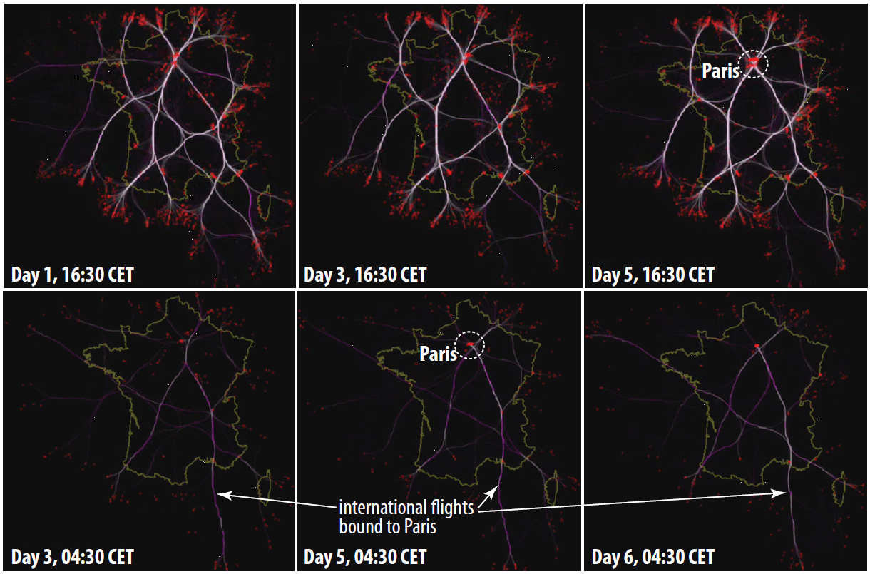
Streaming graph One week France aircraft

Slide 17
Software engineering sequence graph
The dataset contains 22 releases of Mozilla-Firefox[1]
For each revision, we extracted the code hierarchy (folders and files), and code duplicates, using the clone detector SolidSDD[2]
[1] Mozilla. Firefox repository, 2012. http://www.mozilla.org/en-US/firefox/fx
[2] SolidSource IT. SolidSDD Clone Detector, 2012. http://www.solidsourceit.com
Notes:
First, streams allow defining an infinity of “instantaneous” graphs
In contrast, graph sequences contain a finite set of graphs which have been explicitly computed in specific ways
For the sequence-based visualization, you surely have to explain that
* we need correspondences
* we can actually use here ANY static-bundling method, not just KDEEB; the only reason we use KDEEB is that it's simple and fast

Slide 18
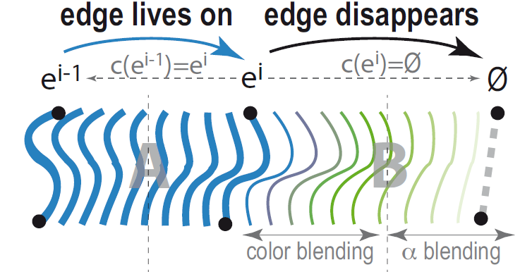
Disappearing edge sequence graph

Slide 19
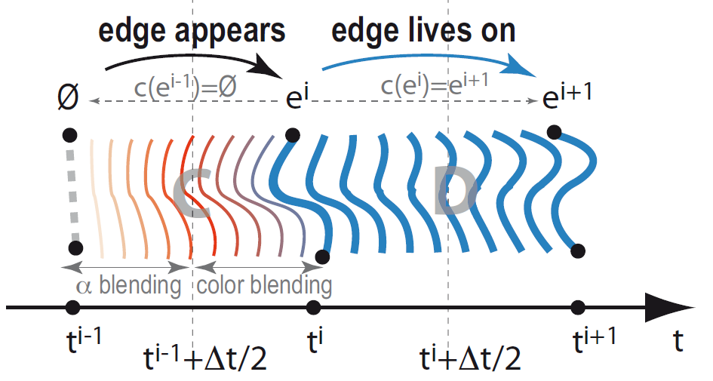
Edge appearing sequence graph

Slide 20
Sequence-based visualization for clones in Firefox
Top row: HEB bundling. Bottom row: KDEEB bundling

Slide 21
Sequence-based visualization for Wicket call graphs
Top: SBEB bundling. Bottom: KDEEB bundling

Slide 22
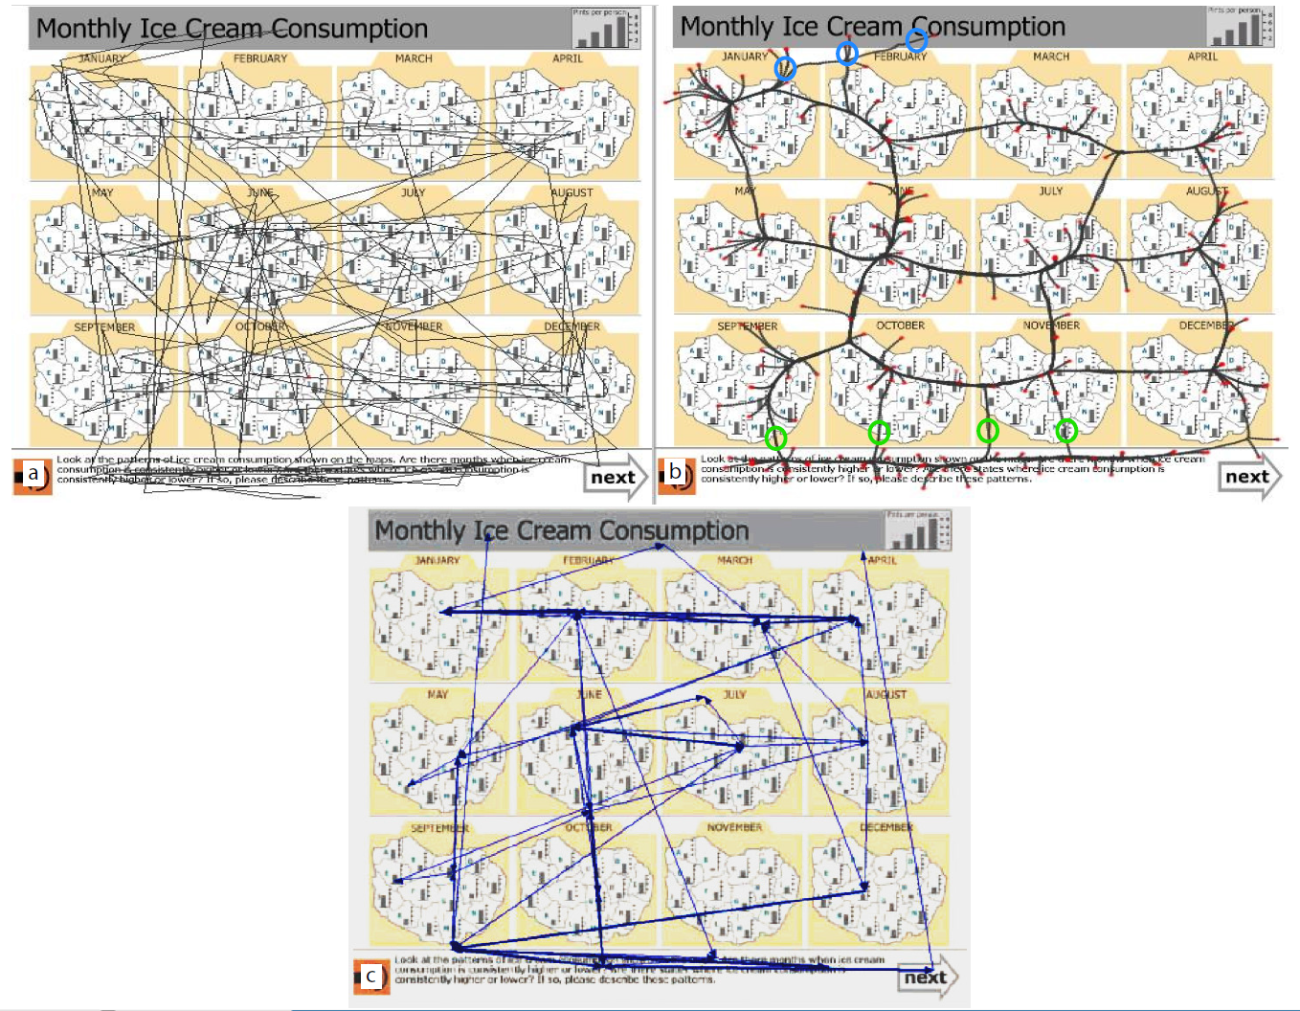
Eye tracking data
Eye tracking data of a subject viewing a small multiples display. (a) Raw trails. (b) Bundled trails. (c) Summarized trails
[Hurter et al. TCVG 2013]
Notes:
Small multiple displays (SMDs) is a well-known technique used in
information visualization to compare a small set of similar objects by
representing them side-by-side using similar visual encodings. They
are effective in helping users to compare such objects and find pairwise
differences or the scope of alternatives in a given set of options [55].
Although SMDs are typically static, several researchers argue for
a continuum between static visualizations and dynamic visualizations,
such as our dynamic graphs presented earlier. Krygier et al. characterize
this continuum using interactivity intensity [34]: At one end, static
graphics afford mental (internal) interactivity. For example, a SMD
is mentally interactive in the sense that users can proactively control
with their eyes the viewing order of this sequence; they can, for instance,
choose to study the sequence at their own pace and in any order
they wish. In contrast, an animation featuring start, stop, and rewind
buttons is slightly more (externally) interactive, but is less (internally)
interactive, since it must be passively viewed in a predefined order.
In this context, a key challenge is to design objective success measures
to evaluate static vs dynamic visualizations [19]. For this, Fabrikant
et al. proposed the concept of inference affordance [20, 10] that
integrates informational equivalence (amount and quality of content)
and computational equivalence (inference quality and efficiency based
on design) between two such displays [49]. To do this, they asked
subjects to study a static SMD showing ice cream consumption over
12 months over the counties of a fictitious country, and next answer
several questions on the data [20]. The subjects’ eye movements were
recorded and displayed atop of the SMD (Fig. 12 a).
However, raw eye movements are too unstructured to address task
T2. To handle this, Fabrikant et al. proposed a combination of data
categorization, i.e., the classification of temporal (sub)sequences into
different classes, by extracting relevant sequence features; and data
summarization, i.e., the simplified depiction of the gaze’s dynamics,
by agglomerative clustering of similar saccades. Figure 12 c shows
a summarization of the trails in Fig. 12 a.

Slide 23
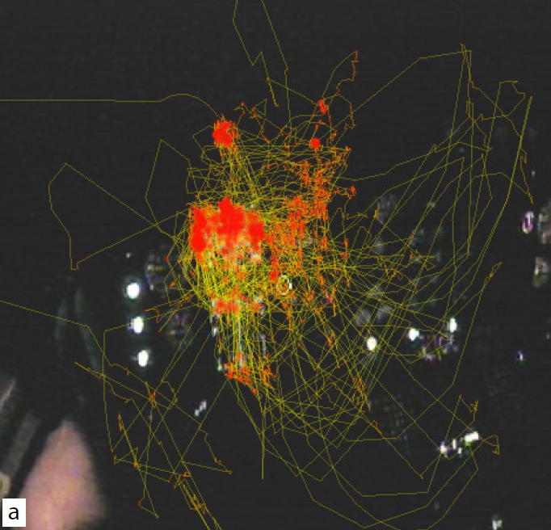
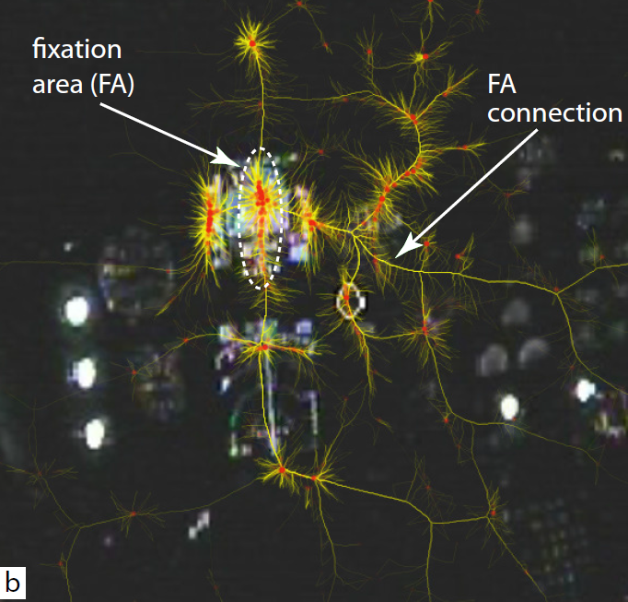
Eye tracking data
[Hurter et al. TCVG 2013]
Notes:
Figure 13 a shows a frame from a video recorded in a flight simulator
engine. The simulation was performed at the EAB [15], the
French authority responsible for safety investigations into incidents
and accidents in civil aviation. The background shows the simulator
cabin. Bright spots show the lit dashboard instruments, such as
altimeter, artificial horizon, heading indicator, wet compass, turn coordinator,
and airspeed meter. The jagged curve in the foreground is
the entire recorded trail of the pilot’s gaze, recorded with the Pertech
system [42] (similar to Figs. 11 b and 12 a). To estimate the FAs, we
compute the trail’s 2D spatial density r, using the same technique as
for graph bundling (Sec. 3.2, Eqn. 4). Coloring the trail by r using a
heat colormap (yellow=low, red=high) shows several red spots, which
match the FAs. Toggling the trail visualization on and off, we can
check if the FAs correspond to the dashboard instrument locations that
were required to be scanned during the training sequence. However,
just as for the example in Fig. 11 c, this image does not show how the
pilot’s gaze navigated between instruments – in other words, it does
not show the structure of the scanning sequence (task T2).
However, the analysis in Fig. 13 removes the time dimension, as
we bundled all eye saccades in a single image. This delivers a coarse
summarization of the eye movement, thus tells us which FAs the subject
visually connected during the entire experiment. However, we
also want to analyze how the gaze dynamics changed across various
time intervals. For this, we use the stream bundling (Sec. 3.2) with a
window D set to a few seconds.

Slide 24
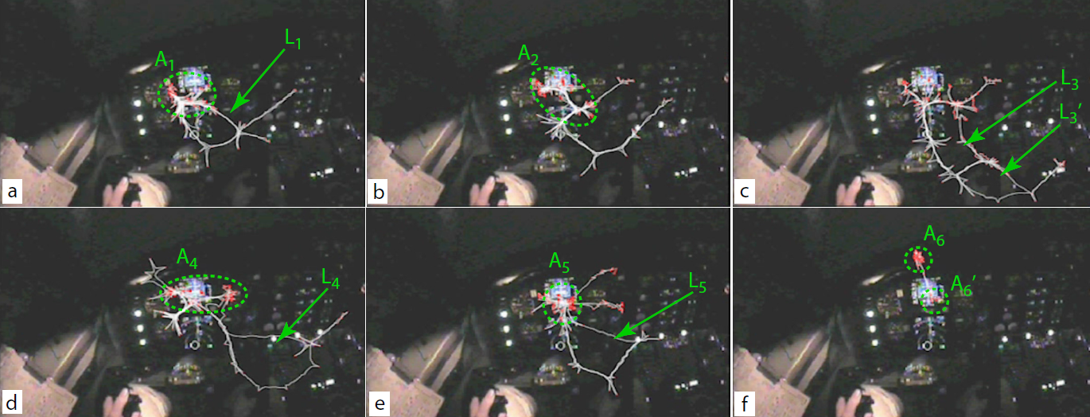
Streaming data eye tracking
Visual analysis of pilot eye-tracking data, with dynamic bundling. Six salient eye-movement patterns are shown
[Hurter et al. TCVG 2013]
Notes:
Figure 14 shows the results for six
consecutive moments where interesting patterns were detected. In image
(a), we see how the pilot’s attention mainly focuses on the central
instruments (FA area A1), while also doing a quick scan of peripheral
instruments (loop L1). Next, the pilot keeps on focusing on the central
instruments (FA area A2, image (b)), while the peripheral scanning
pattern is similar, but breaks the earlier loop structure. Next, in image
(c), the pilot focuses more on the peripheral instruments, as denoted
by the two scanning loops L3 and L0
3, but also keeps an eye on the
central instruments, as these loops are connected to the central screen
area. In image (d), we see a repetition of the initial pattern (a), with
the pilot focusing on the central instruments (A4) and quickly scanning
the periphery (L4). The same pattern persists in image (d), as seen by
comparing A4 vs A5 and L4 vs L5. At the end of the training sequence
(image (f)), the pilot focuses most on two instruments of the dashboard
center, A6 and A0
6.

Slide 25
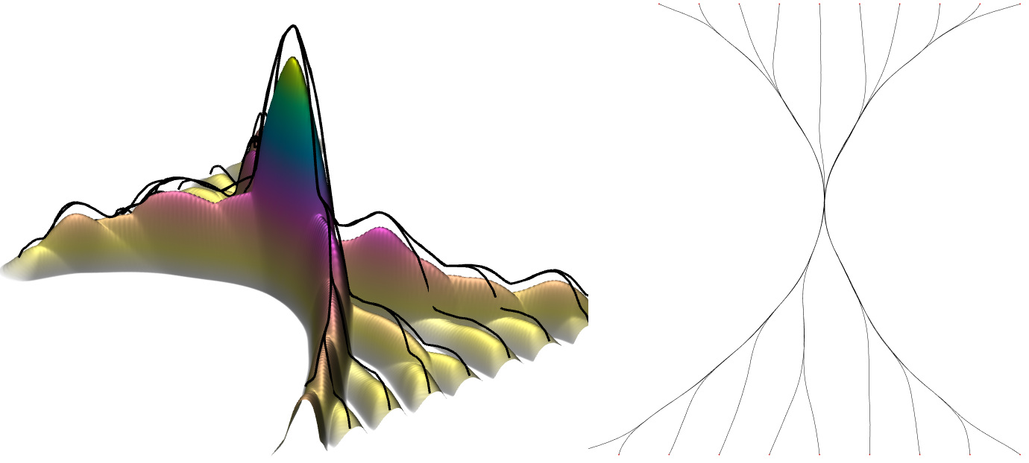
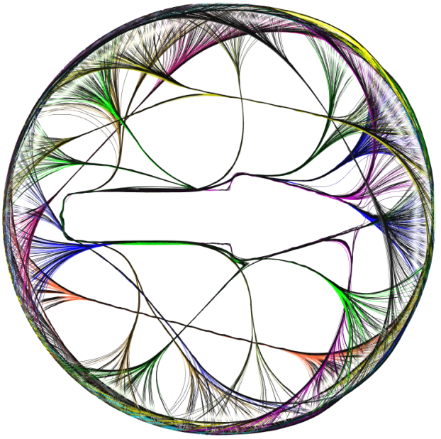
Graph Bundling by Kernel Density Estimation
C. Hurter, O.Ersoy, A.Telea Eurovis 2012
Notes:
Hierarchical Edge Bundling (HEB) bundles edges together
by bending each edge, modeled as a B-spline curve,
toward the polyline path defined by the available hierarchy
[Hol06]. This method is not applicable to general graphs,
since it requires a graph to contain a hierarchy.

Slide 26
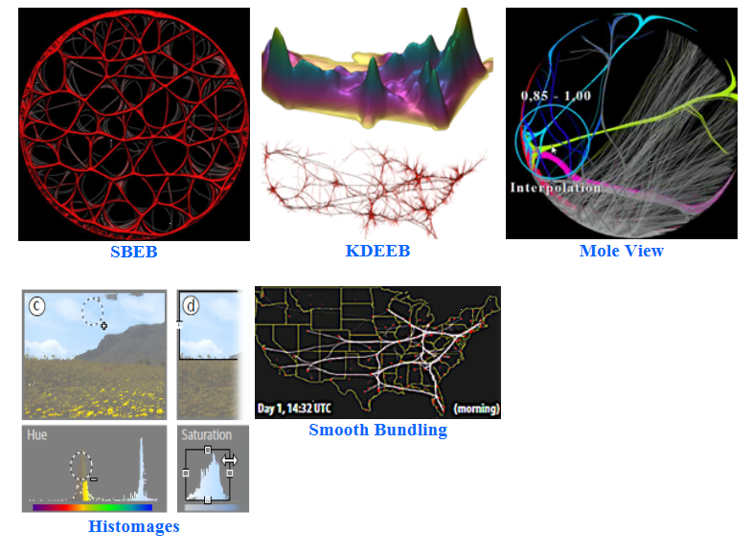
Code
http://www.recherche.enac.fr/~hurter/
Available code

Slide 27
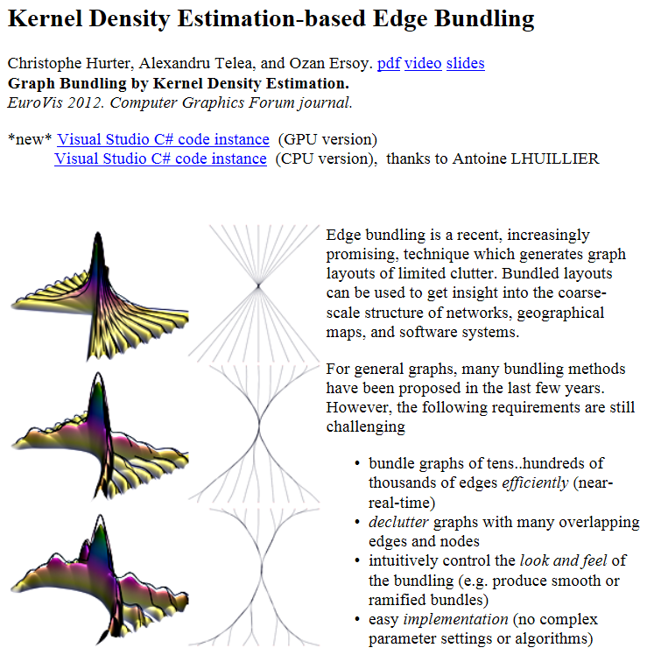
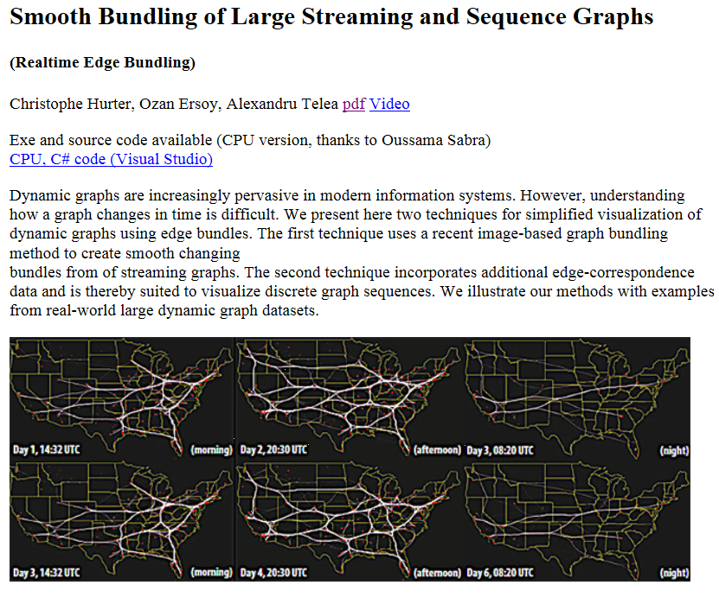

Slide 28
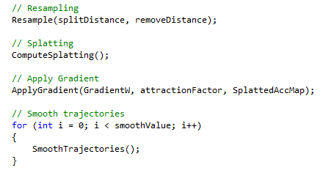
KDEEB

Slide 29
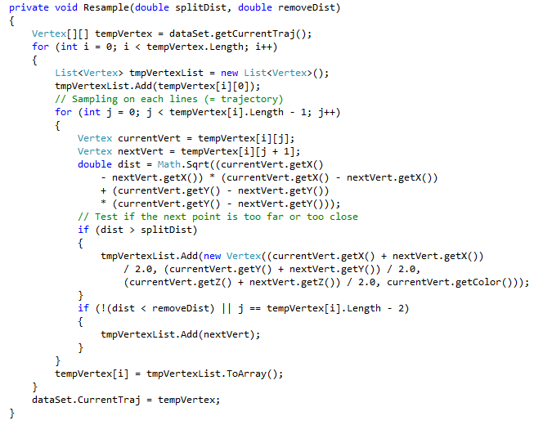
Resampling

Slide 30
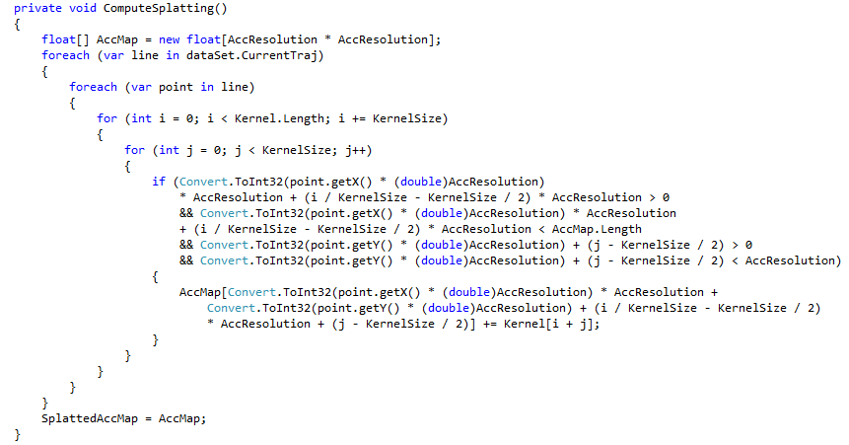
Splatting

Slide 31
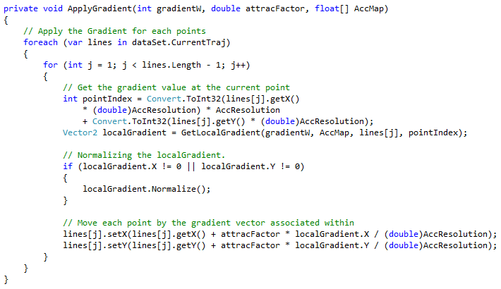
Apply Gradient

Slide 32
Smooth Trajectories

Slide 33
Open Research Questions
Lack of benchmarks to assess and compare the efficiency of existing and new algorithm
Lack of task-based taxonomy. “What is the best technique to solve my problem?”
Lack of quality metrics. “What is a good result? How much better is the result from method A compared to method B?”
Notes:
Hans

Slide 34
Edge Bundling Open Questions
Many techniques, no task based taxonomy
No dataset to perform computation benchmark, and task validation
Some algorithm are complex and it is hard to forecast effects of EB parameterization
Edge Bundling produces lot of overlapping with Collinearity issues. No general solution to solve it.
Little work addressed directed edge visualisation
Notes:
Christophe

Slide 35
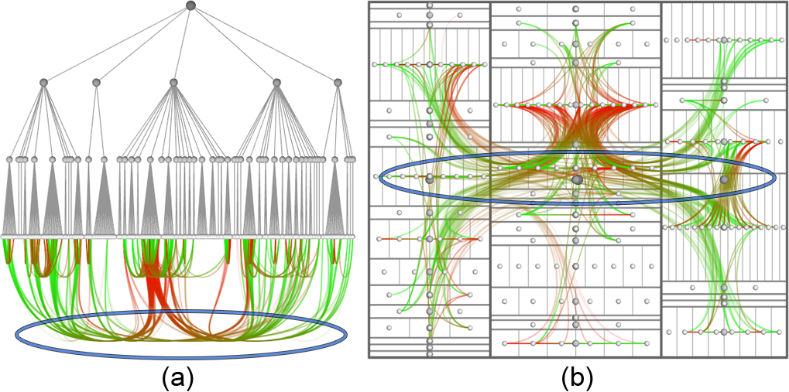
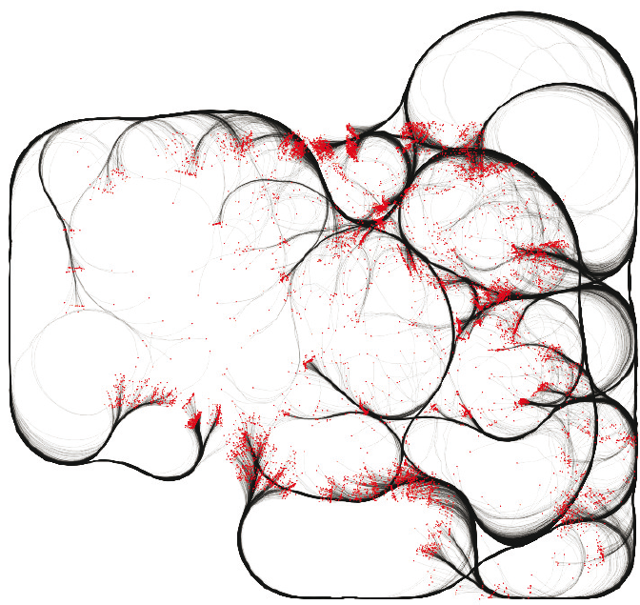
Collinearity problems
[Holten Infovis 2006]
[Hurter et al. Eurovis 2012]
Notes:
Christophe

Slide 36
Existing solutions: Benchmarks
Benchmark Data Set: University of Florida Sparse Matrix Collection http://www.cise.ufl.edu/research/sparse/matrices/
[Davis+Hu 2011]
Notes:
Christophe

Slide 37
Existing solutions: Task Taxonomies
Task Taxonomy for Graph Visualization [Lee et al. 2006]
Topology-based Tasks (adjacency, accessibility, common connection, connectivity)
Attribute-based Tasks (on nodes, on links)
Browsing Tasks (follow path, revisit)
Task Taxonomy for Network Evolution Analysis [Ahn et al. 2012]
Entities (node/link vs. group vs. network)
Properties (structural properties vs. domain attributes)
Temporal Features (individual events vs. aggregate events)
Notes:
Hans

Slide 38
Existing solutions: Quality Metrics
[Tufte 1983]:
Data Density – points to display / available Pixels
Data-Ink-Ratio – points to display / used Pixels
[Ellis+Dix 2006]:
overplotted% – %age of Pixels with >1 point
overcrowded% – %age of points in overplotted Pixels
hidden% – %age of points that are hidden from view
Notes:
hans

Slide 39
Time for Questions
Make sure to download a copy of the slide deck @ http://tinyurl.com/tutorial2013

Slide 40
Part II: EDGE SET SIMPLIFICATION Existing software
Notes:
Java, c#, open source…

Slide 41
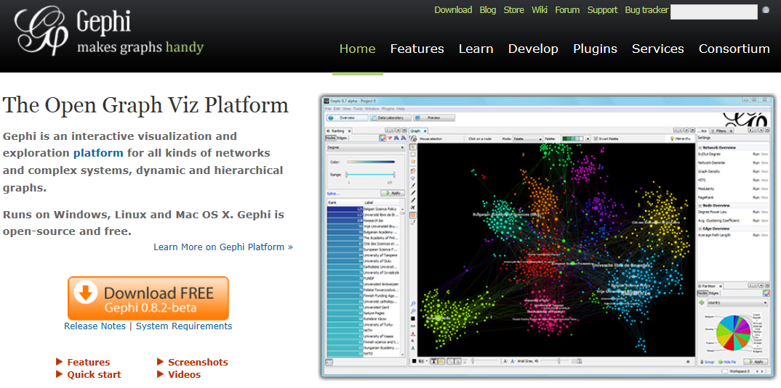
https://gephi.org/

Slide 42
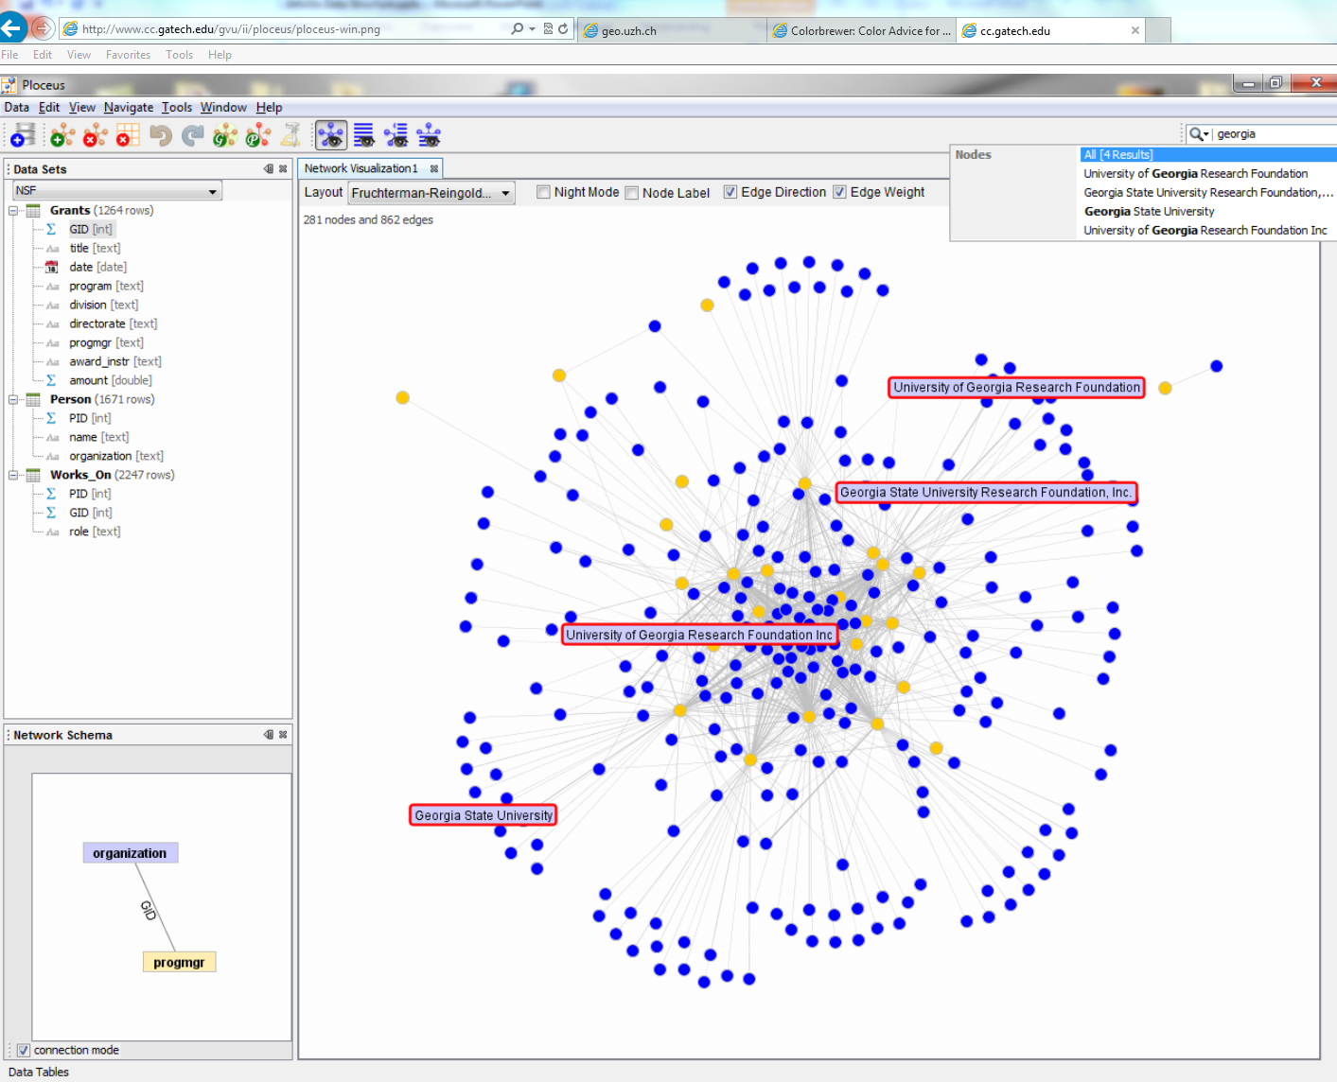
Ploceus Network-based Visual Analysis of Tabular Data
http://www.cc.gatech.edu/gvu/ii/ploceus/
Even when a given table design conveys some static network semantics, analysts may want to look at multiple networks from different perspectives, at different levels of abstraction, and with different edge semantics.
Zhicheng Liu, John Stasko, VAST 2011
Notes:
Get Video!
In Ploceus [26], one can display networks from different perspectives, at different levels of abstraction, and with different edge semantics.

Slide 43
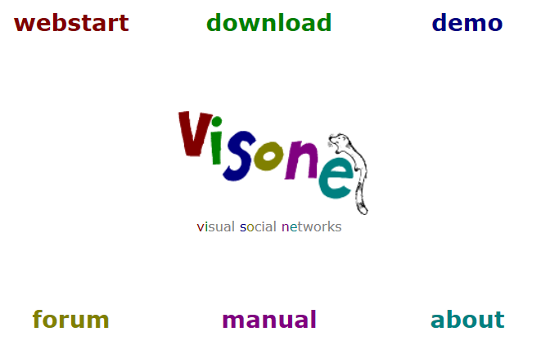
Visone
http://visone.info/
Notes:
visone is a long-term research project (team), in which models and algorithms to integrate and advance the analysis and visualization of social networks are being developed.
an important part of visone is the design and implementation of a software tool intended for research and teaching in social network analysis. It is specifically designed to allow experts and novices alike to apply innovative and advanced visual methods with ease and accuracy.
JAVA
visone is free for academic and research purposes, and no registration is required. Simply use Java Web Start to run the latest released version, or download any of the following (i.e., right-click on a link and select “Save Link As…”).

Slide 44
Orion: A System for Modeling, Transformation and Visualization of Multidimensional Heterogeneous Networks
http://vis.stanford.edu/papers/orion
Orion’s interface enables the rapid manipulation of large graphs—including the specification of complex linking relationships— using simple drag-and-drop operations with desired node types.
Jeffrey Heer, Adam Perer, (VAST), 2011
Notes:
Get Video

Slide 45
Tulip
http://tulip.labri.fr/
Auber, D. Tulip : A Huge Graph Visualisation FrameWork. Graph Drawing Software. Springer- Verlag, 2003, 105-126.
Notes:
C++
Not open source
Available API

Slide 46
Commercial solution: Palantir
http://www.palantir.com/
They build software that allows organizations to make sense of massive amounts of disparate data. We solve the technical problems, so they can solve the human ones. Combating terrorism. Prosecuting crimes. Fighting fraud. Eliminating waste. From Silicon Valley to your doorstep, we deploy our data fusion platforms against the hardest problems we can find, wherever we are needed most.

