Slide 1
Connecting The Dots - Showing Relationships in Data and Beyond
Marc Streit¹, Hans-Jörg Schulz², Alexander Lex³
VisWeek Tutorial 2012
Johannes Kepler University Linz, Austria
University of Rostock, Germany
Harvard School of Engineering and Applied Sciences, Cambridge, MA, USA

Slide 2
Part II: HOw To Link?
Speaker: Alexander Lex

Slide 3
Schedule
3:15 – 3:40 First half
3:40 – 4:15 Coffe break
4:15 – 4:50 Second half
4:50 – 5:50 When to link? By Marc Streit

Slide 4
Contents
1. Discussion of objectives, definitions
2. Establishing quality criteria
3. Brief introduction to most linking techniques
4. Detailed discussion of selected linking techniques
5. Details on techniques that employ connectedness

Slide 5
Linking Objective
Express a relationship between n entities, which is not obvious from the visual encoding.
Supplementary relationships, e.g., based on
brushing
clustering
derived relationship
Consequence:
must work in supplement to the primary visual encoding, the base representation (BR).

Slide 6
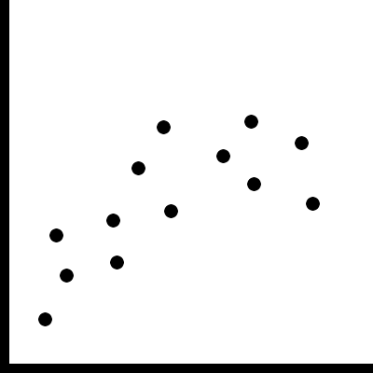
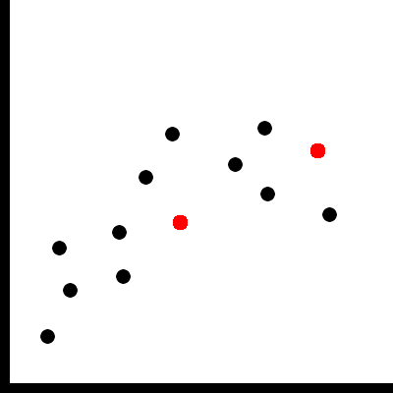
Base Representation (BR)…
… is a visualization or an image which is meaningful by itself
… may be adapted to enable linking
Base Representation
with supplemented links

Slide 7
How To Link?
Linking of information based on perceptual grouping principles.
Gestalt principles [Wertheimer, 1923] and recent extensions
Good resource for grouping principles and other issues of perception:
http://www.csc.ncsu.edu/faculty/healey/PP/index.html
By Christopher G. Healey

Slide 8
Quality Attributes for Links (1/2)
Scalability for # items
How many items can be linked for one relation?
Scalability for # relations
How many relationships can be shown at the same time?
Perception issues
Can the links be perceived easily or “preattentively”?
Can all entities belonging to a relationship be easily identified?

Slide 9
Quality Attributes for Links (2/2)
Occlusion issues
Is the base representation preserved?
Compatibility to base representation?
Is the choice of visual encoding for a link suitable for the encoding of the base representation?
Practical/Implementation issues?
Easy to implement?
Efficient to implement?
Notes:
It might be acceptable to (partially)
occlude
modify
the base representation
Not all forms of encoding visual links work with all encodings in a BR

Slide 10
Quality Attributes Online
http://connecting-the-dots.caleydo.org

Slide 11
Critique: Visual Encoding Conventions
Good, suitable, feature inherent!
Limiting, but good technique might address the problem.
Limiting, but may work under certain circumstances.
Severely limiting, no (known) solution.

Slide 12
Three Major Classes of Links
Proximity
Similarity
Connectedness

Slide 13
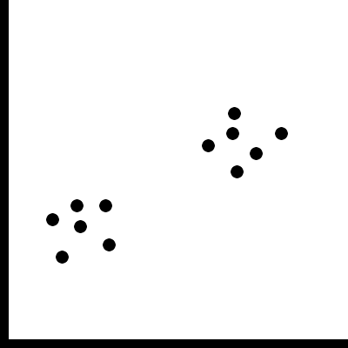
Proximity
Grouping/linking by placing entities in close proximity

Slide 14
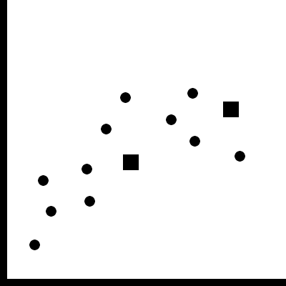
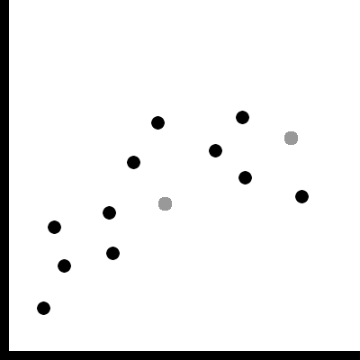
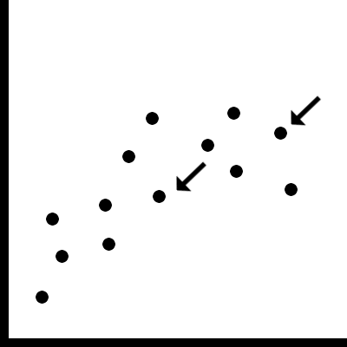
Similarity
Co-modulation of a visual-variable [Bertin 1974]
color, shape, size, value, orientation, texture, …
Adding a glyph, label, frame, background
Color
Shape
Value
Glyph

Slide 15
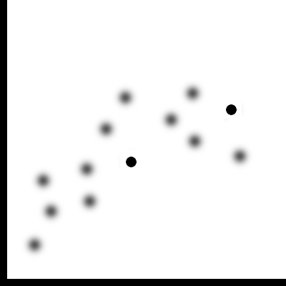
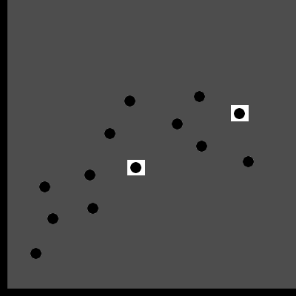
Similarity
Modulate everything else
Blurring, darkening, desaturating, etc.
Blur
Darkening

Slide 16
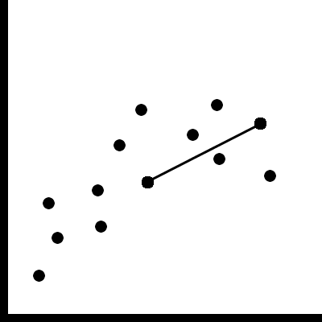
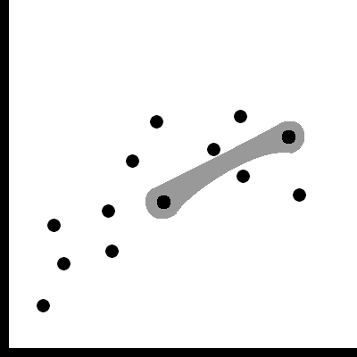
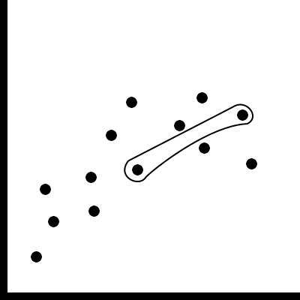
Connectedness and Common Region
Connected items with a line or curve
Surround items with a outline, surface, volume
Connectedness
Surface
Outline
Common Region

Slide 17
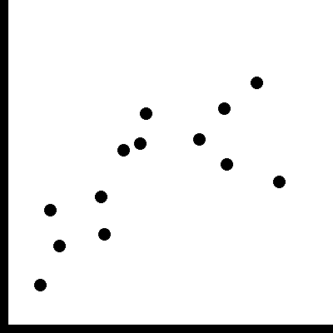
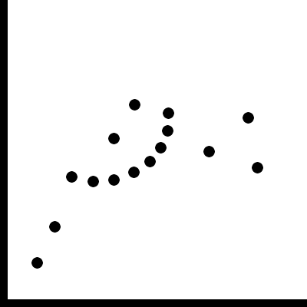
The “obscure” grouping principles
“Obscure” in terms of applicability for linking
Common fate
motion in the same direction
Good Continuation
arrange items on a line / curve
in consequences similar to position but more limited

Slide 18
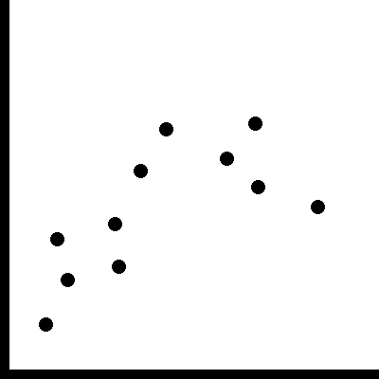
The “obscure” grouping principles
Flicker
Works well for a few items
Grabs your attention
Often perceived annoying

Slide 19
Proximity

Slide 20
Proximity
Scalability for # items: very good
Scalability for # relations: very good
Perception: very good
Occlusion issues: not really
Practical/implementation issues: not really
Notes:
Scalability:
very many items
Can become „tight“ if good grouping criteria is not fulfiled – as hansi explained
Compact: elements in cluster are similar
Separated: clusters are different
Balanced: cluster membership is equally probable
Parsimonious: much fewer clusters than data objects

Slide 21
Proximity: Compatibility to BR
Problematic because:
position is „the best“ visual variable → in very many cases used as a primary encoding
adding relationships (e.g. by brushing) triggers significant rearrangement
difficult to keep up mental map

Slide 22
Proximity Uses
Is used only when position is variable
e.g., in graphs using a node-link layout
e.g., when using projection/MDS methods: to emphasize individual dimensions
e.g., sorting in a table

Slide 23
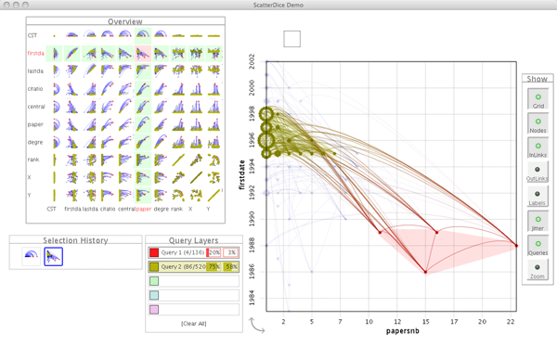
Proximity in Graphs
GraphDice
System to see relationships between large quantities of node attributes in graphs
[Brezerianos et al., 2010]
Notes:
Inria/Purdue @ EuroVis 2010

Slide 24
Proximity - Graph Dice
[Brezerianos et al., 2010]

Slide 25
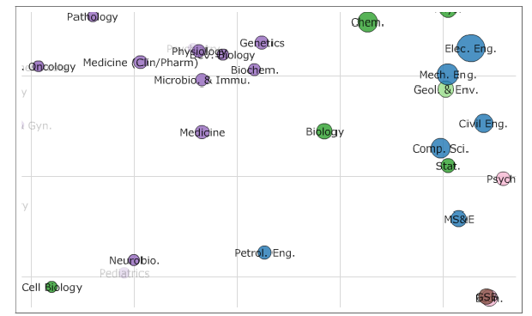
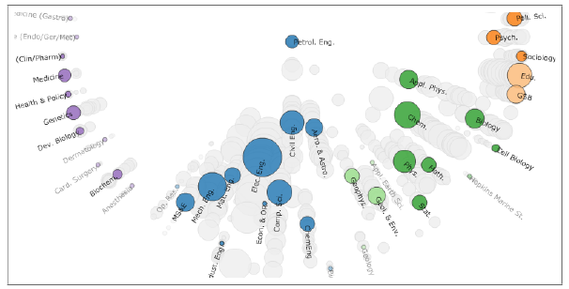
Proximity - MDS
Topical distances between depratments in a 2D projection
Topical distances between the selected Petroleum Engineering and the others.
[Chuang et al., 2012]
Notes:
Sandford group @ CHI 2012

Slide 26
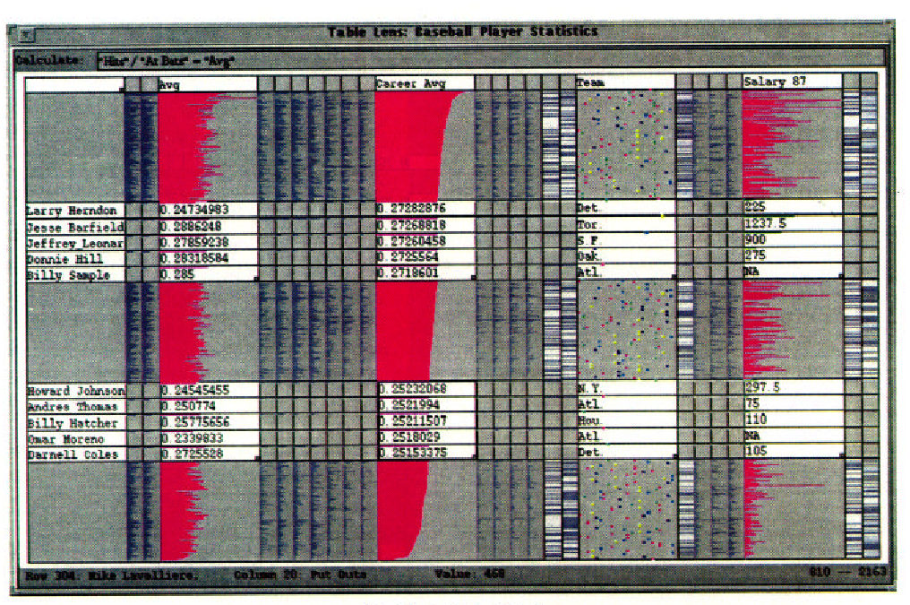
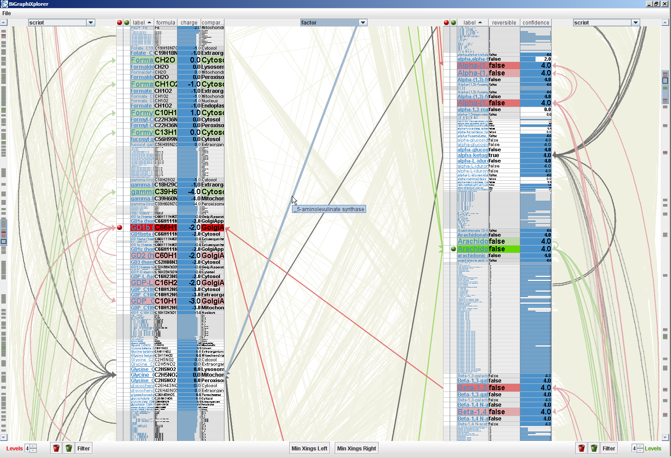
Proximity - Sorting
Table-Lens sorted according to one dimension.
Bi-partite graph with tabular display for node attributes.
[Rao and Card, 1994]
[Schulz et al., 2008]
Notes:
Table Lens: CHI
Hansi: VCBM

Slide 27
Proximity Reccomendation
Use proximity if your primary visual encoding doesn‘t use position.
Proximity is also often combined with other visual encodings for links.
Notes:
dual encoding makes it more obvious, trustworthy
common example: observable clustering in scatterplot is enhanced by color

Slide 28
Similarity

Slide 29
Similarity - Color
Scalability for # items: very good
Scalability for # relations: limited (7-8 colors can be easily distinguished)
Occlusion issues: not really
Compatibility to BR: good if color is „free“
Practical/implementation issues: not really

Slide 30
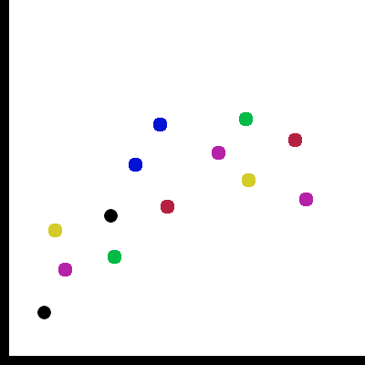
Color – Perception Issues (1/2)
Preattentive properties: Very good for 1-2 simultaneous, serial search for more

Slide 31
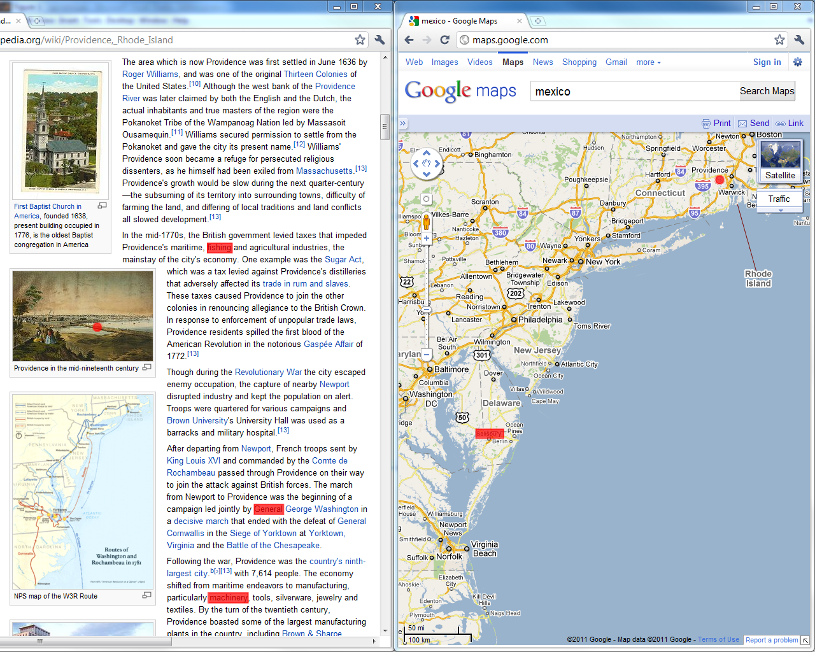
Color – Perception Issues (2/2)
Slower in a cluttered environment
Size of colored object relevant.
Notes:
Point to hidden dot on picture

Slide 32
Color Reccomendation
Use color if
position is already used
you expect large numbers of elements
you expect a limited number of simultaneous relationships
Be careful if
the BR is cluttered
its important that no entity is overlooked

Slide 33
Value / Saturation / Transparency
Value / Saturation / Transparency
Similar to color
Lower # of relations
Influences visibility
Often used for binary selections/filters

Slide 34
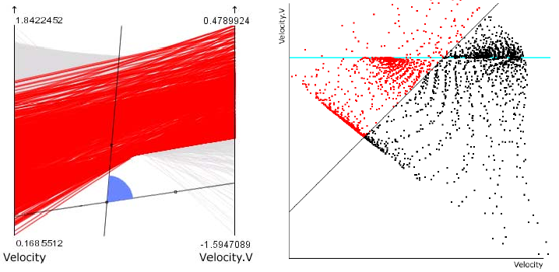
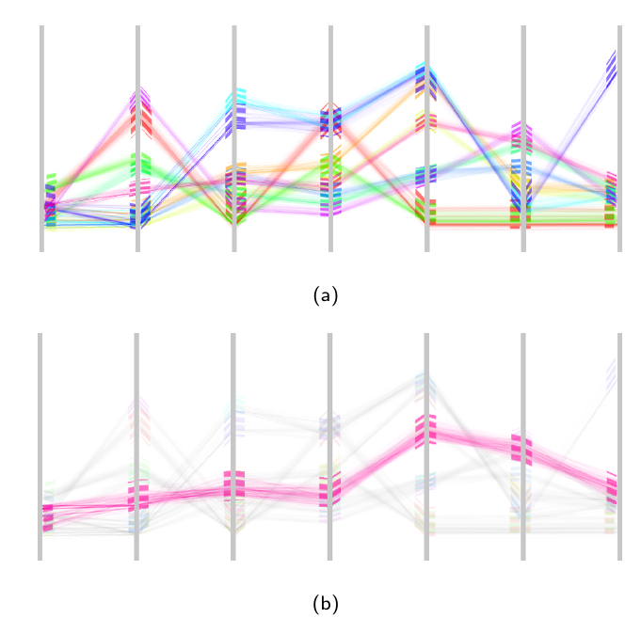
Color/Value Modulation Examples
[Hauser et al., 2002]
[Doleisch , 2007]
[Johansson et al. , 2007]

Slide 35
Other Modulation-Based Similarity
Shape
Less easily perceived than color.
Better for larger # of relations, but doesn’t work preattentively.
Less flexible – requires a scatterplot-like setup
e.g.: exchange symbol used in a scatterplot
Requires a minimum size of a mark
Size
Problematic for larger # of relations.
May lead to occlusions.
e.g.: make line in PC plot thicker
Notes:
Shape:
e.g. you know a lot of shapes from symbols, traffic signs and
they are obvious to distinquish
Doesn‘t work for many encodings – e.g. Parallel coordinates plots, line charts, theme-river, etc
Size:
works for highlighting individual items

Slide 36
Other Modulation-Based Similarity
Orientation
Special requirements on the mark and on the BR
-> limitations of shape apply
Texture
Special requirements on the mark
Minimum size of mark
Notes:
Orientation:
you have to have marks that have a clear orientation. A dot, for example, does not
Texture:
Putting texture on a pc plot will be difficult – but could be done – i.e. stippling

Slide 37
Similarity based on Supplementation
Glyph, label
Same problems as for shape
Scalability for # relations: very good
Scalability for # items: bad, introduces additional clutter
Frame & background
Often combined with color to counter-balance small/thin features of mark otherwise binary only
Notes:
Only that instead of directly exchanging a mark an exiting mark is supplemented

Slide 38
Similarity based on Modulating Everything Else
Blurring, darkening the surrounding
Perception: good
Scalability # items: very good
Scalability # relations: practically only 1 possible
Compatibility to BR: BR may become hard/impossible to read
Practical issues: blur sometimes difficult to implement
Notes:
Perception:
depends also on the BR
works good with items with clear edges – glyphs, lines,
not so good with heat maps, etc

Slide 39
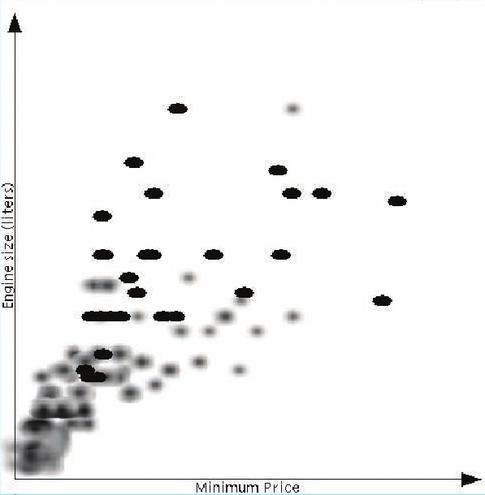
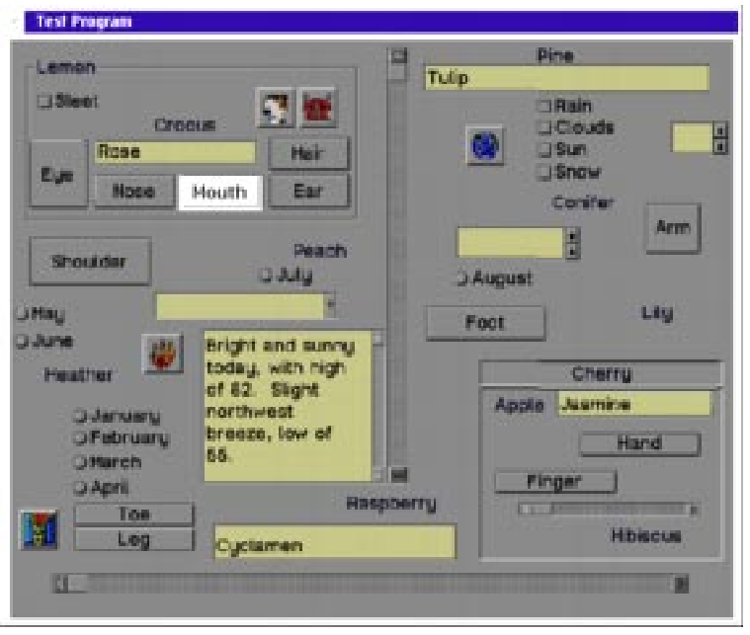
Modulating Everything Else: Reccomendation, Example
Don‘t use unless the sole objective is to guide attention toward one (set of) items
[Zhai et al., 1997]
[Kosara et al., 2002]

Slide 40
Connectedness and Common Region

Slide 41
Connectedness
Scalability for # items: ok, special measures for many
Scalability for # relations: difficult if # items is non-trivial
Occlusion issues: problematic if no special measures are taken
Notes:
@Occlusion – links add a lot of „ink“

Slide 42
A Little Experiment…
Proximity
Color
Size
Shape

Slide 43
Connectedness
Perception issues:
Connections can be perceived preattentively
Very strong grouping principle
Good at pointing at outliers
Practical Issues:
Basic implementation trivial & fast
Counter-balancing for the mentioned issues comes at a cost
Notes:
Perception:
Even works for elements outside of field of view

Slide 44
Common Region
Very similar to Connectedness
At what point is a line an area?
More „ink“ necessary
Reduces possible # items and # relations
Increases saliency
Alternative if edges already used
Can be used with transparency to preserve BR

Slide 45
Connectedness Varieties
Bubble Sets
Line Sets
Kelp Diagrams
Image by [Dinkla et al., 2011] Technique by [Collins et al.,2009]
[Alper et al., 2011]
[Dinkla et al., 2012]

Slide 46
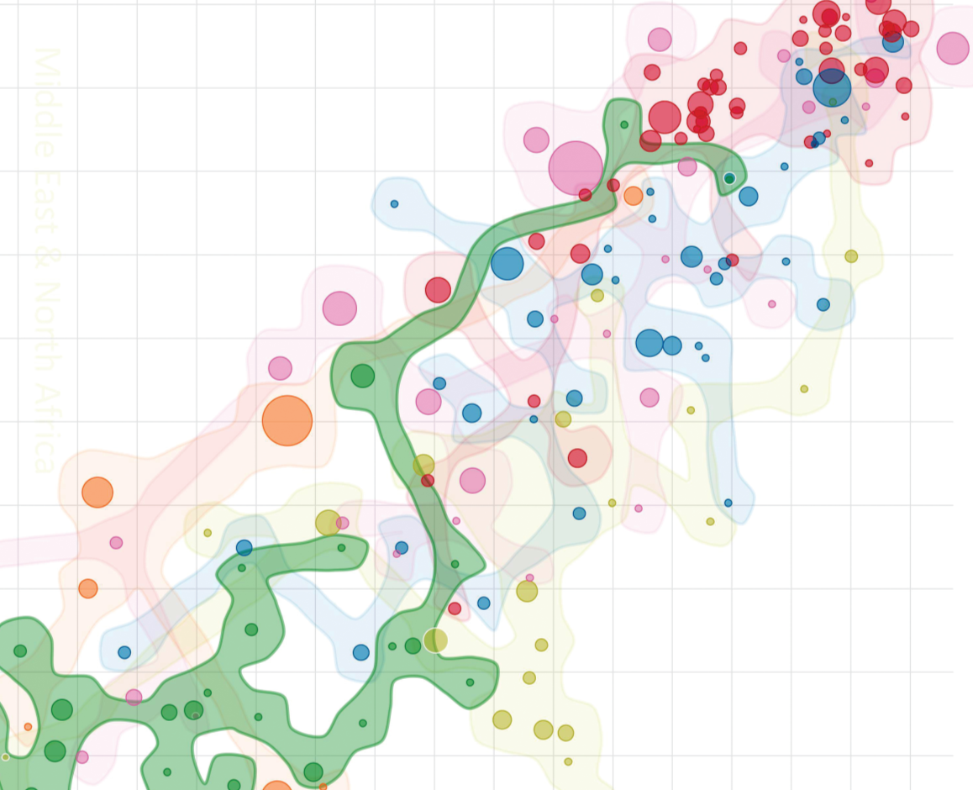
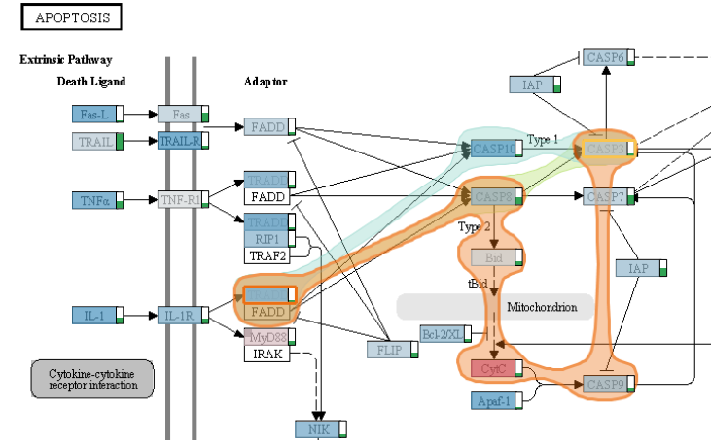
Bubble Sets
[Collins et al., 2009]
[Partl et al., 2012]

Slide 47
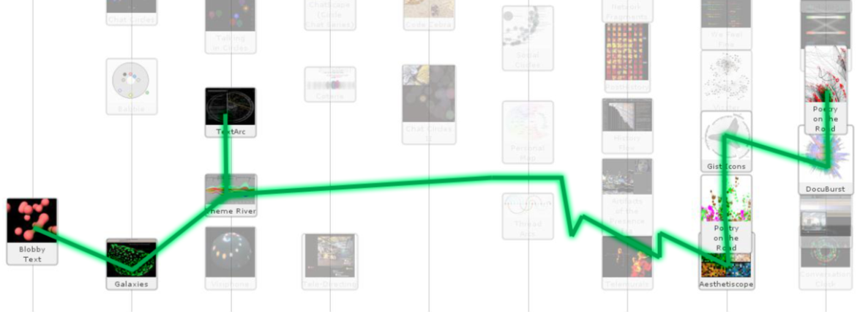
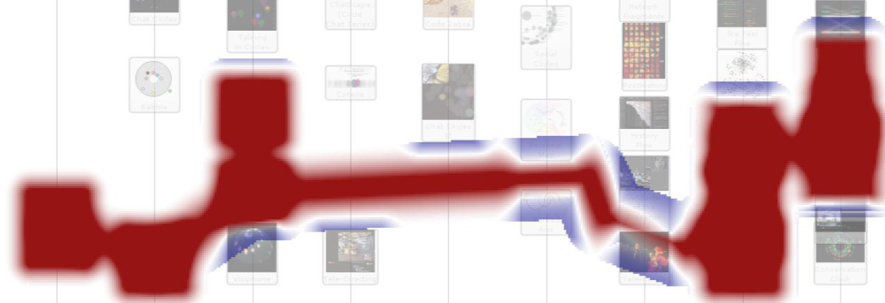
Bubble Sets
How it works:
Approach: connect nodes through virtual edges (route around obstacles) and compute a contour from this initial polyline
[Collins et al., 2009]
Positive (red) and negative (blue) energy fields, which guide the construction of the contour

Slide 48
“Advanced” Euler Diagrams
Compact Rectangular
Euler Diagrams
Euler Diagrams
with Duplicates
[Riche & Dwyer, 2010]

Slide 49
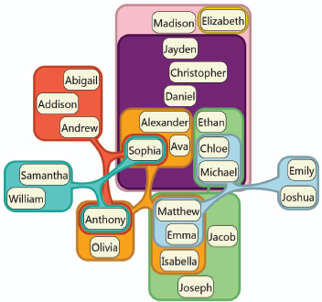
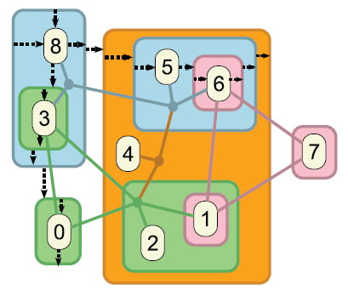
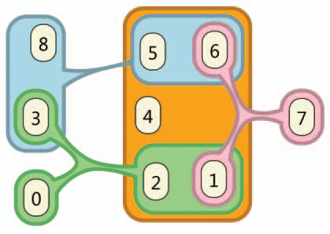
Compact Rectangular Euler Diagrams
How it works:
start with an edge representation, use a force directed layout and transform from edges to shapes
[Riche & Dwyer, 2010]

Slide 50
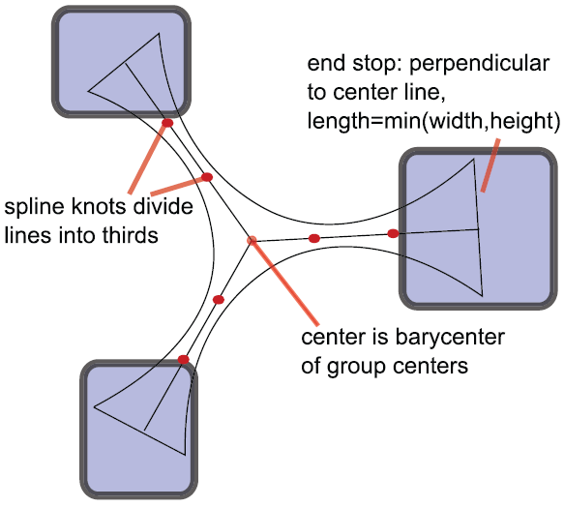
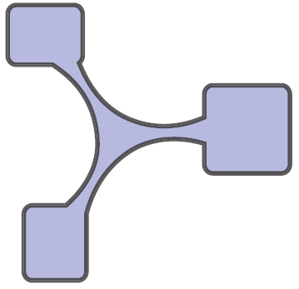
Compact Rectangular Euler Diagrams
How it works:
[Riche & Dwyer, 2010]

Slide 51
Addressing Scalability, Occlusion Issues
Scalability:
Using abstraction
Bundling
Occlusion
Modifying the BR
Routing
Notes:
Only these two fullfill the „supplementing“ critereon for linking

Slide 52
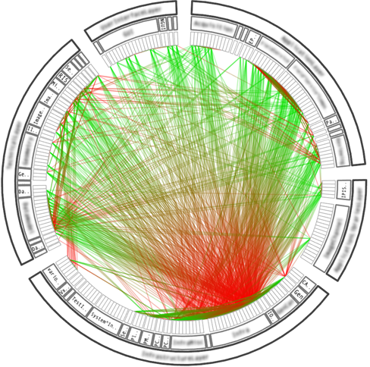
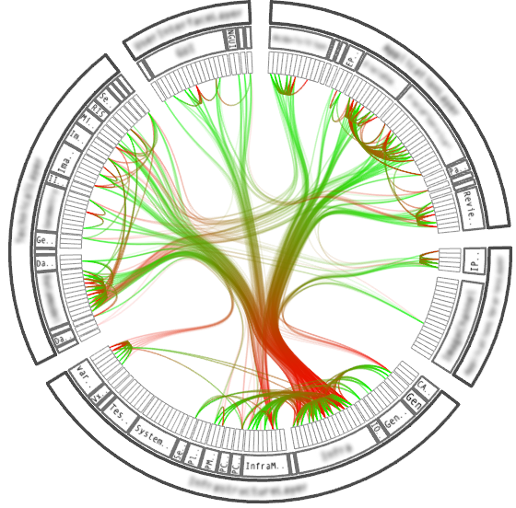
Bundling - HEB
Hierarchical Edge Bundling (HEB)
Can be used for links within a tree.
[Holten, 2006]
Notes:
Example: Software System and Call Graph
Notice that the layout of the base representation is suitable to this type of linking

Slide 53
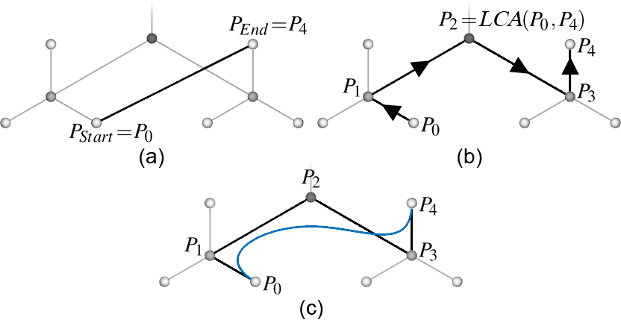
Bundling - HEB
How it works:
[Holten, 2006]

Slide 54
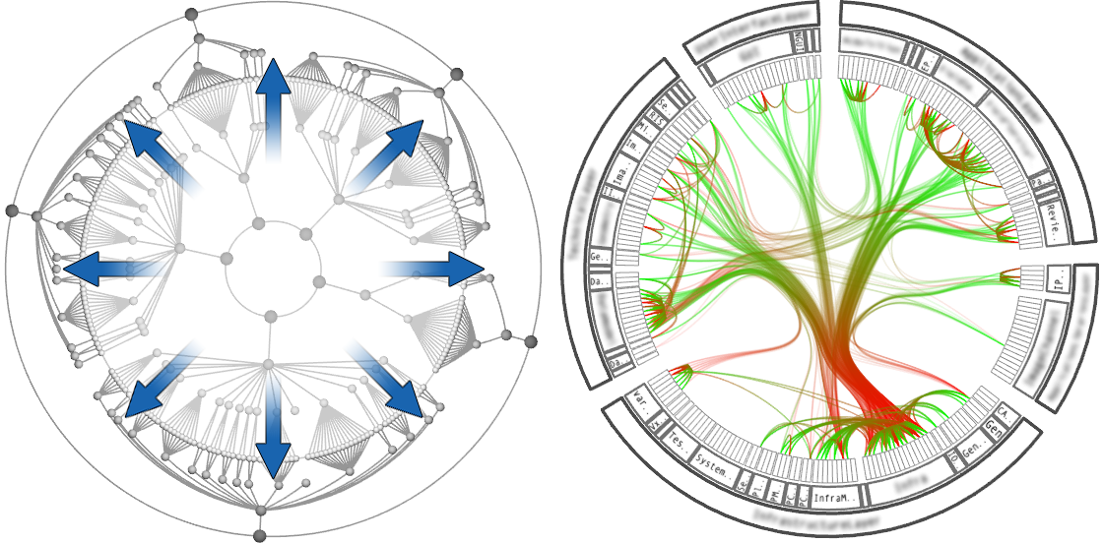
Bundling - HEB
The underlying structure
[Holten, 2006]

Slide 55
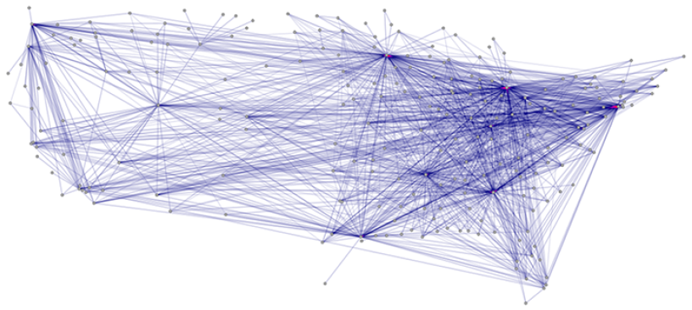
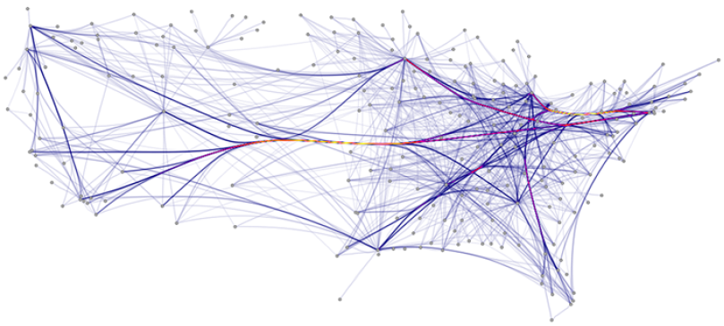
Bundling - FEB
Force-Directed Edge Bundling
[Holten & van Wijk, 2009]

Slide 56
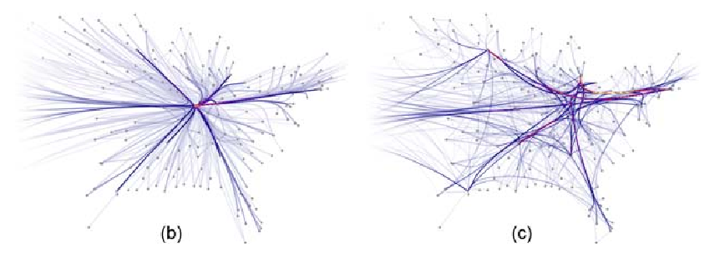
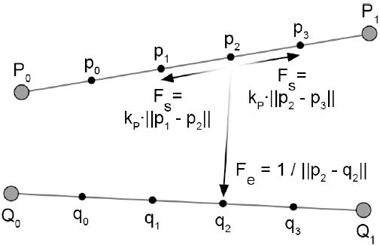
Bundling - FEB
How it works:
Edge Comaptibility
Angle
Length
Position
Visibility
[Holten & van Wijk, 2009]

Slide 57
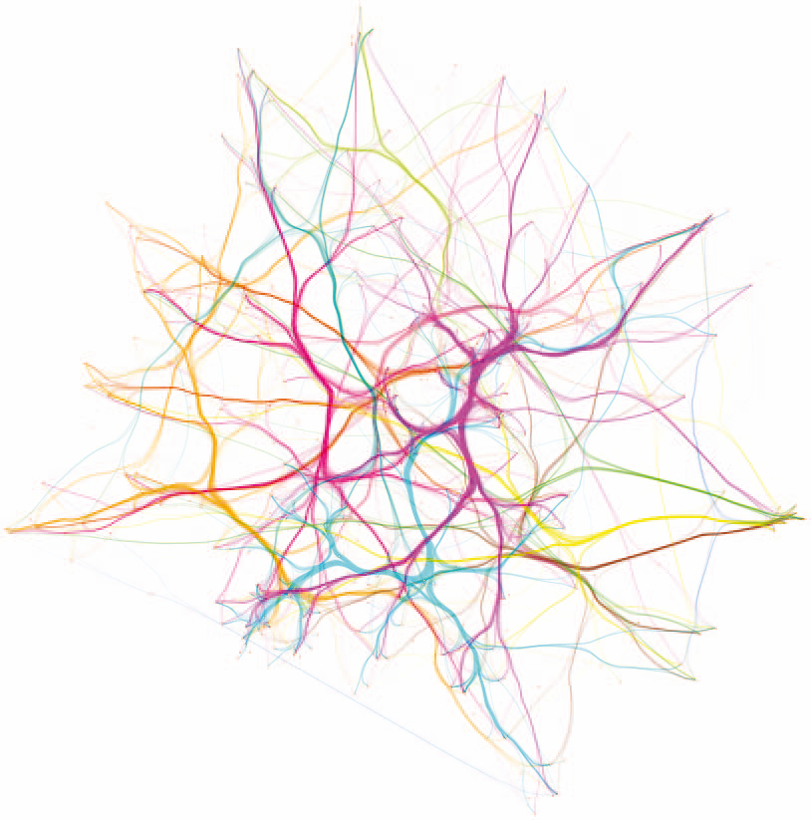
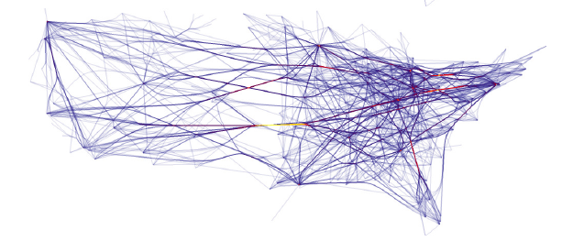
Other Bundling Approaches
Skeleton-based edge bundling
based on Clustering
Agglomerative bundling
minimizing ink (collapsing edges in proximity)
[Esroy et al., 2011]
[Gansner et al., 2011]
Notes:
Skeleton:
edges are clustered,
shapes for the clusters created,
skeleton for the cluster calcolated
edges attracted to skeleton

Slide 58
Routing
Case Study Context-Preserving Visual Links
Material based on InfoVis 2011 Talk by Markus Steinberger

Slide 59
Again a little experiment ;) …

Slide 60
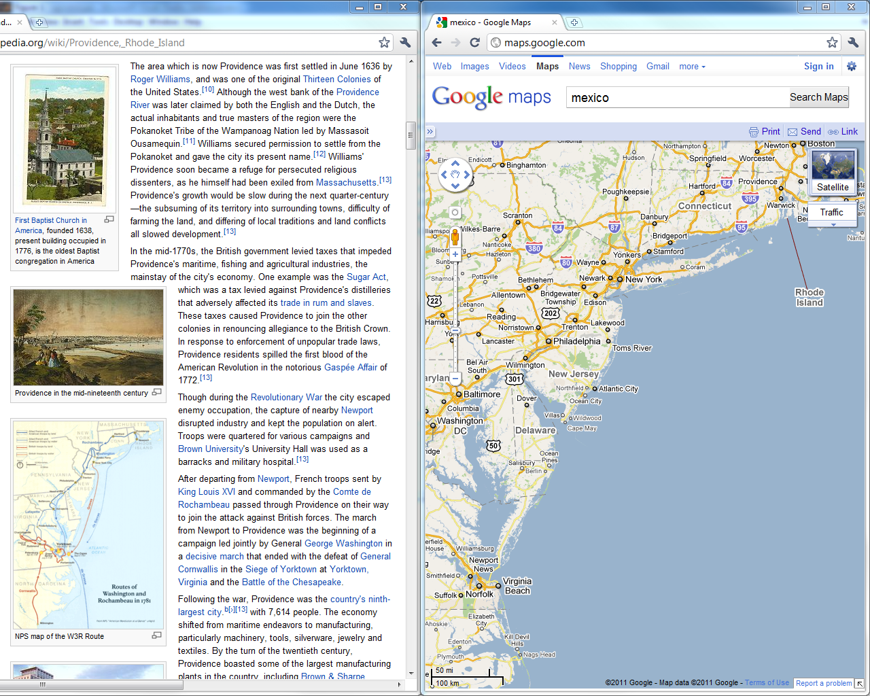
Notes:
Base representation
various highlighting techniques around

Slide 61
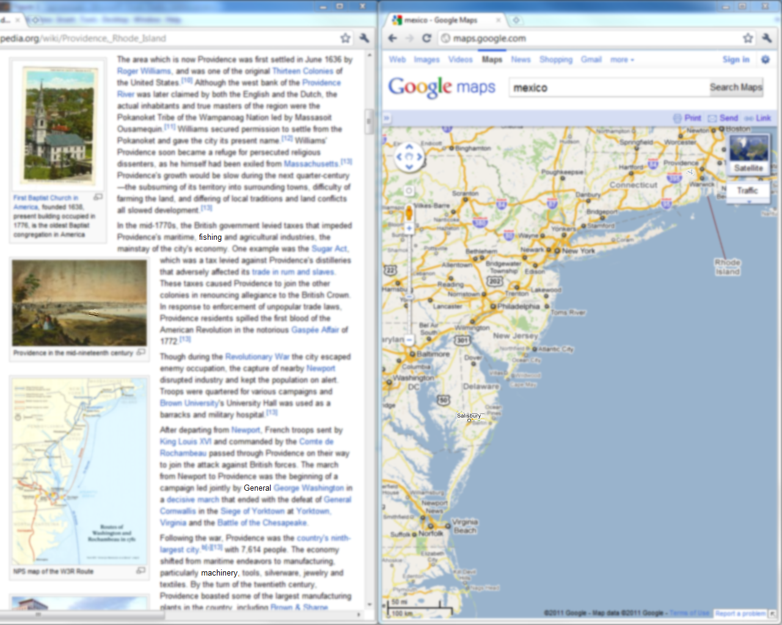

Slide 62
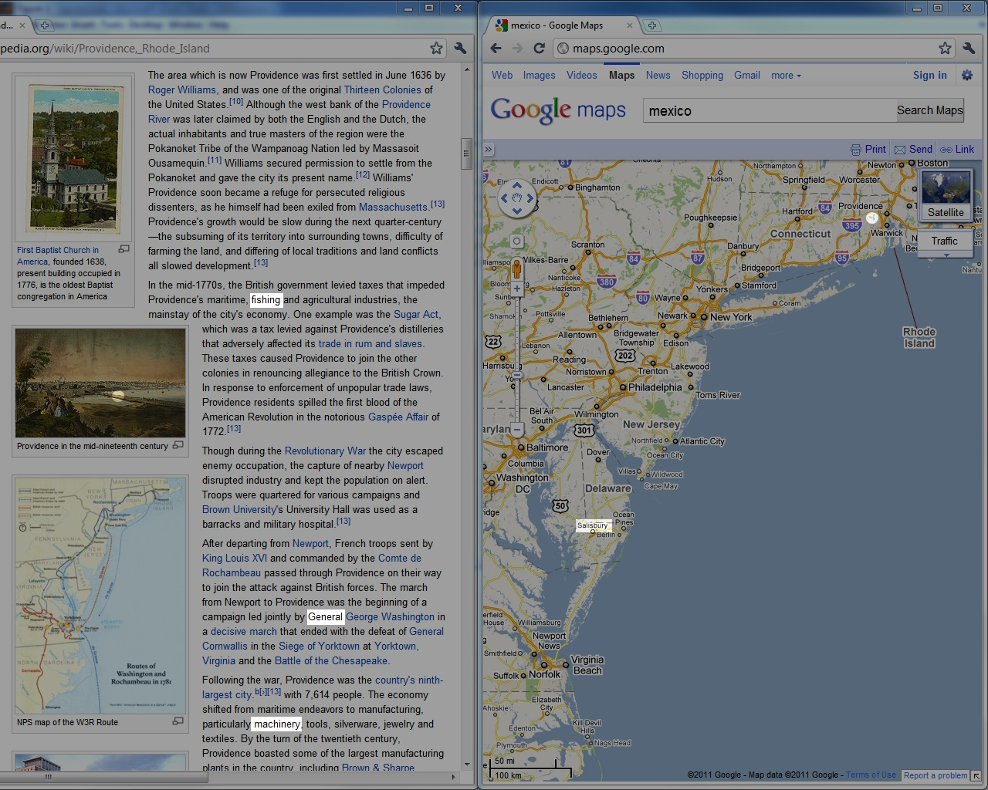

Slide 63
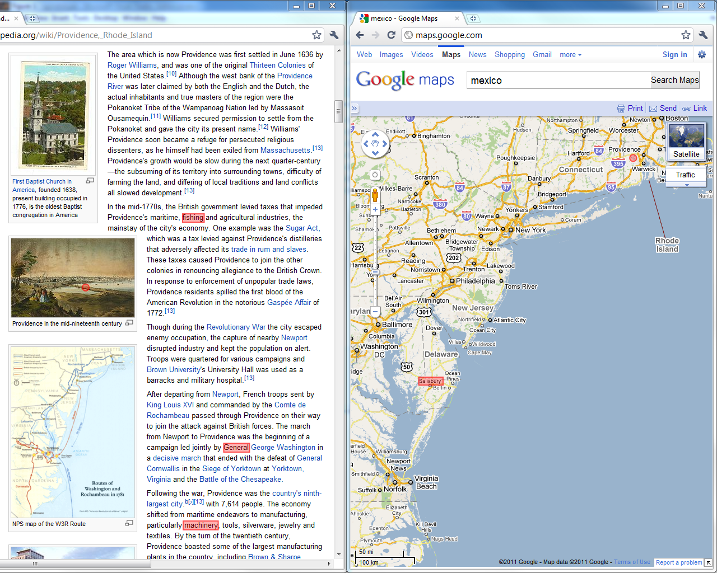

Slide 65
What is the problem?
Notes:
Advantages sagen für großen screen (oder auch bei blinking)

Slide 66
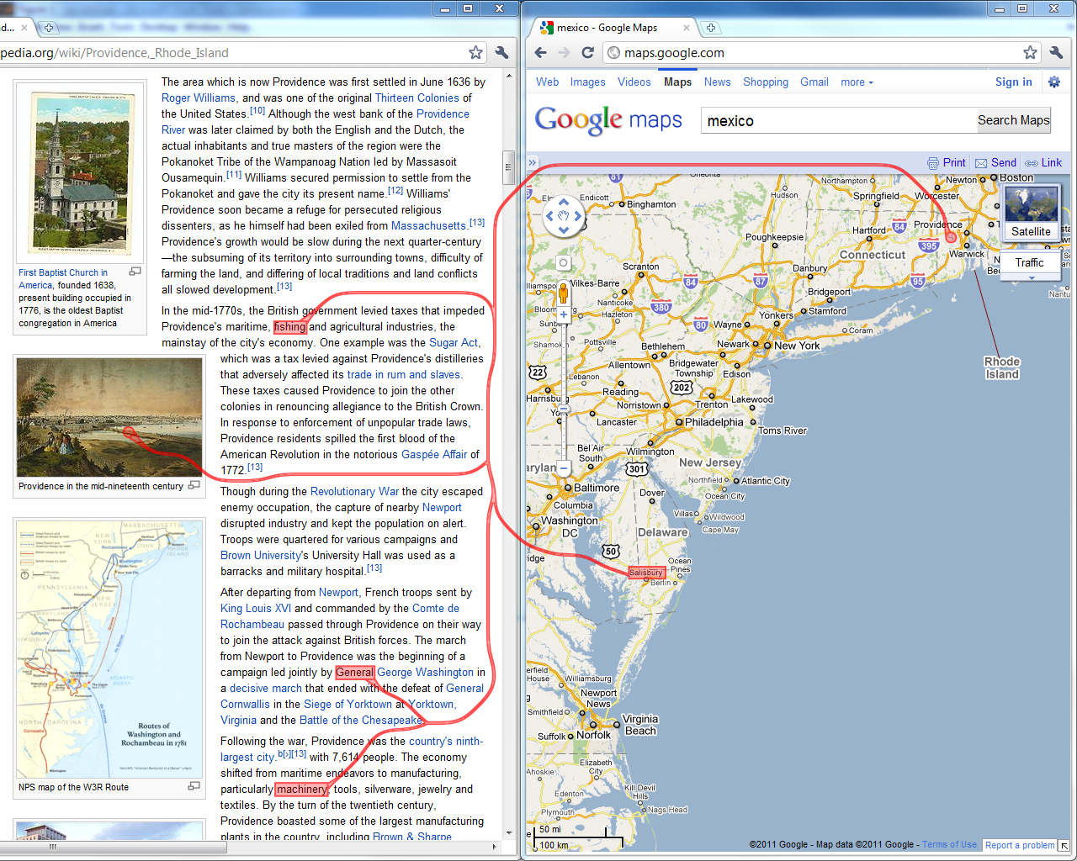
Context-Preserving Visual Links

Slide 67
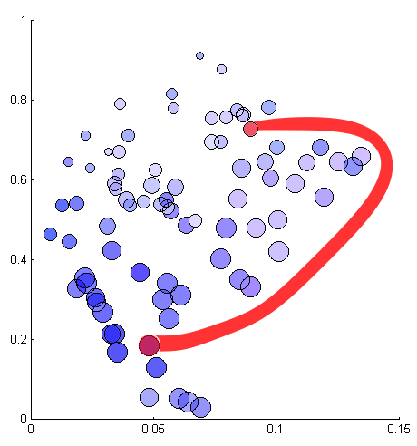
Design Goals: Optimal link routes…
minimal length
minimal occluded information
visually distinguishable
unnecessary link-segments are avoided (bundling)

Slide 68
Tradeoff

Slide 69
System Overview
Penalty Map Creation
Routing
Rendering

Slide 70
Important Content
Bottom-Up Visual Saliency [Itti 98]
Based on human visual system
What stands out in images
Ignores high-level cognitive system
Notes:
Base on contrast

Slide 71
Saliency for a complex scene

Slide 72
Color Similarity
Non-fixed link color: choose distinguishable color
Otherwise: compute color similarity for every region
Requires base representation as image

Slide 73
Highlight Regions
Avoid highlight regions and their surrounding
Realized by using blurred version of highlight regions

Slide 74
Other Link Sets
To support multiple linksets, we require a fixed priority among the linksets
Add high priority links as regions to avoid

Slide 75
Combined Penalties
+
=

Slide 76
System Overview
Penalty Map Creation
Routing
Rendering

Slide 77
Routing
Multiple source shortest path problem
Penalty map for crossing different regions
Discretized version
Modified version of Dijkstra‘s Algorithm
Notes:
Additional pic (rendered)

Slide 78
Technique applied to Caleydo

Slide 79
Evaluation: Hypothesis
Visual links lead to a better performance than conventional highlights.
Context-preserving visual links do not have a negative impact on performance.
Context-preserving visual links have a positive impact on user satisfaction.

Slide 80
Task: Visual Search
Count number of highlight regions (5 to 12)
Correctness and speed
Variety of visualizations
Eye-Tracker
Context information not required for task
Notes:
… pathways?

Slide 81
Three Techniques
Frame/color based highlighting
Straight Visual Links
Context-Preserving Visual Links

Slide 82
Results
Visual links lead to a better performance than conventional highlights.
Context-preserving visual links do not have a negative impact on performance.
Notes:
Check significance

Slide 83
Gaze Plots
Context-Preserving Visual Links
Straight Visual Links
Frame based highlighting
Notes:
Show highlight regions also

Slide 84
Results
Context-preserving visual links have a positive impact on user satisfaction.

Slide 85
Context-Preserving Visual Links Summary
Context-preserving visual links …
… avoid occlusion of important content in the BR
… can be adjusted to visually stand out from the BR
… do not harm performance when compared to non-routed visual links

Slide 86
Connectedness Reccomendation
Use connectedness if:
You need the additional ink to make the links stand out from the BR
You want to show many different relationships (e.g. as in a graph)
You can not easily modulate the visual rep of the items
You want to make sure that nothing is overlooked

Slide 87
Connectedness Reccomendation
Be careful if:
You only have a handful of classes but a high # items
You need a very fast implementation
Making connectedness run efficiently is often not trivial!
Notes:
eg. brushing in PCS, scatterplots

Slide 88
What‘s Next: When to Link? by Marc

