Slide 1
Connecting The Dots Showing Relationships in Data and Beyond
Marc Streit¹, Hans-Jörg Schulz², Alexander Lex³
VisWeek Tutorial 2012
Johannes Kepler University Linz, Austria
University of Rostock, Germany
Harvard School of Engineering and Applied Sciences, Cambridge, MA, USA

Slide 2
Motivation
Common task in data analysis and many kinds of information intensive work:
Compare, evaluate and interpret related pieces of information
Notes:
Reveal relationships, patterns, and connections

Slide 3
Let‘s start with a little game…

Slide 4
Do you know this guy?
Wally
Walter
Waldo
Holger
…
http://www.classicmedia.tv/pr/whereswaldo/
Notes:
Well, his name depends from where you are… Let‘s call him wally

Slide 5
Search Task
http://www.findwaldo.com/fankit/graphics/
Notes:
Transition: Let‘s try an easier one…

Slide 6
%
http://tomsvision.wordpress.com/tag/wheres-wally/

Slide 7
In case you wanna have a tattoo…

Slide 8
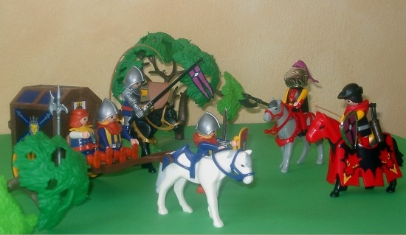
Spot the differences
Comparison Task
Notes:
Comparing, correlating, iterpreting connected pieces of information

Slide 9
What‘s the Problem?
Finding, comparing and interpreting information is error-prone and tedious
→ Support human

Slide 10
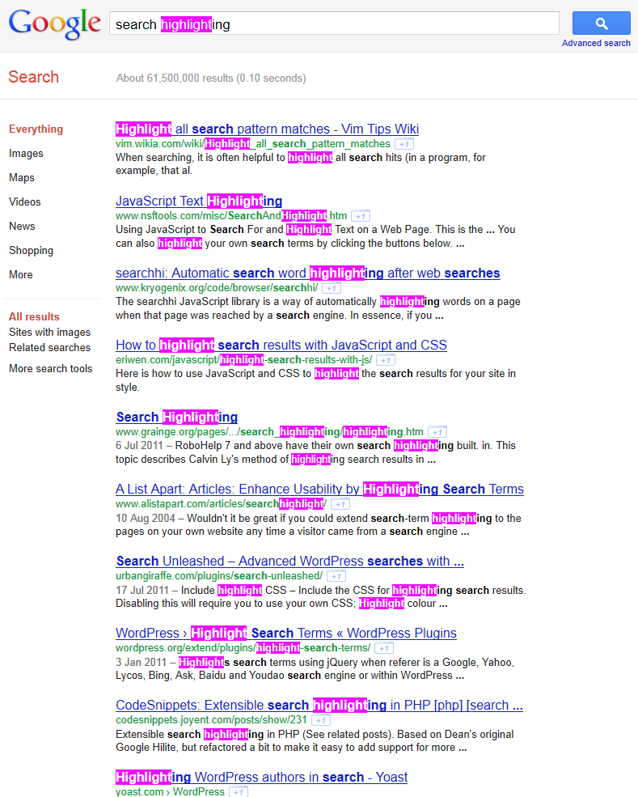
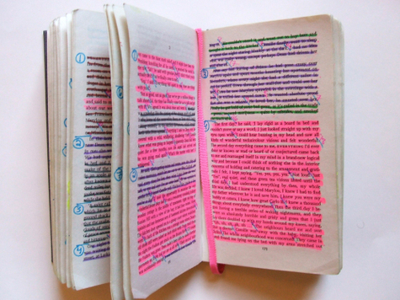
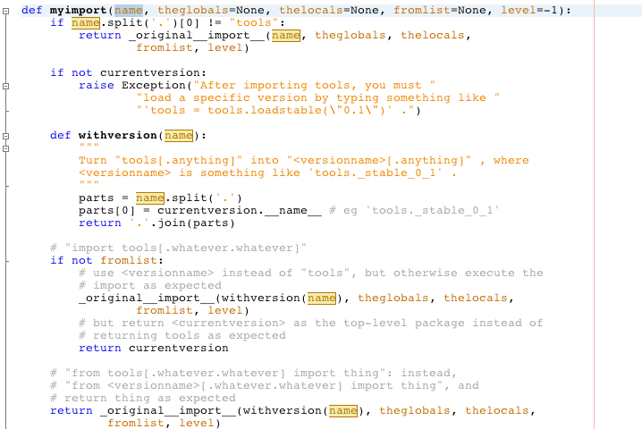
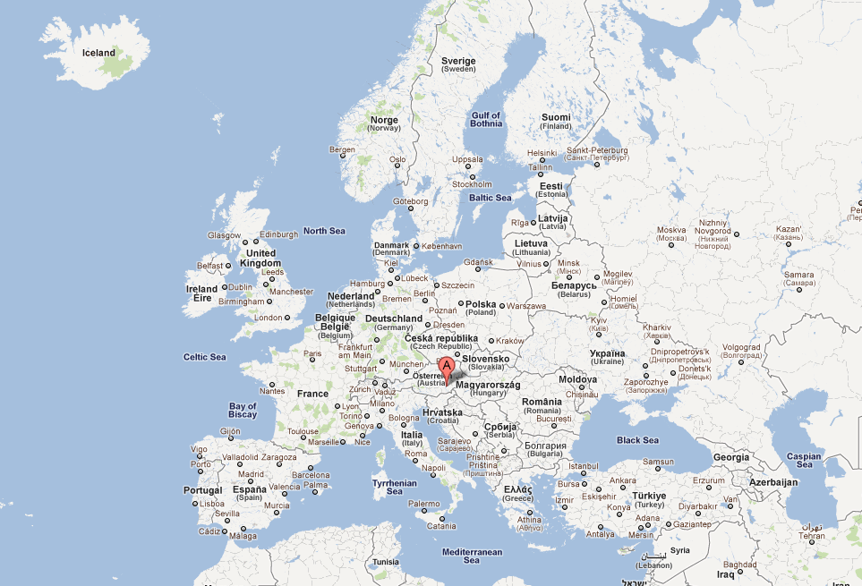
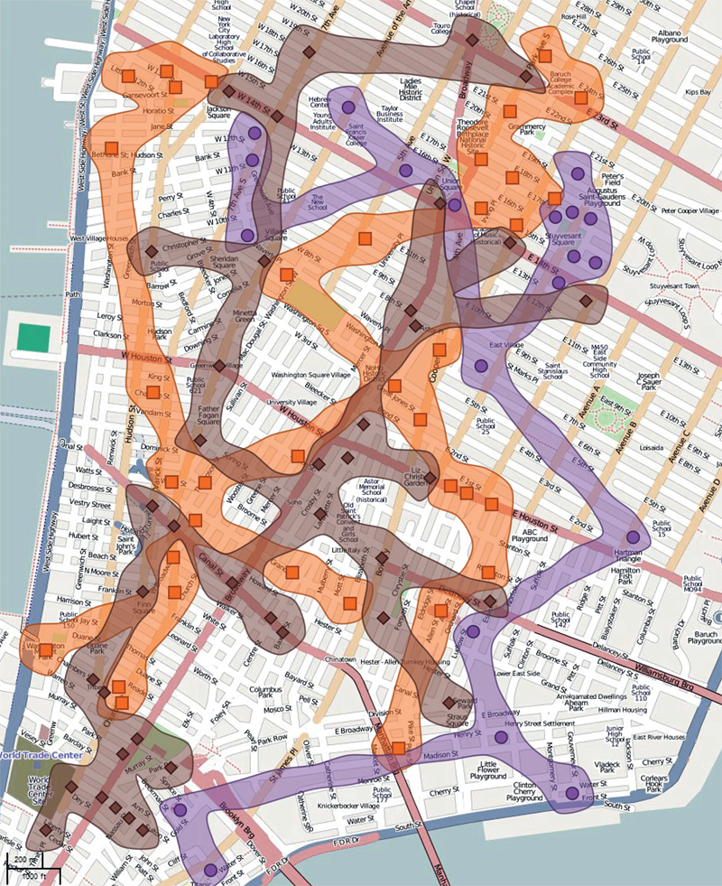
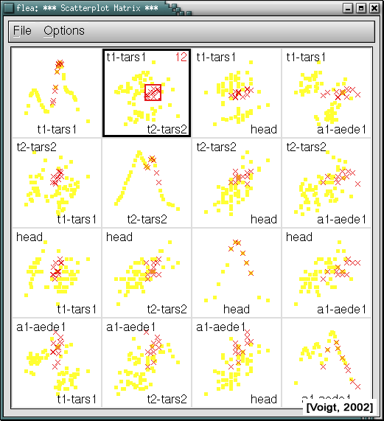
Java Eclipse
Google Maps
Mozilla Firefox
Make things stand out
[Collins ‚09]
Notes:
In real world situations we often want things to stand out…
…
If you use computers, you also find hilighting often… Synchronized visual highlighting
Well-known technique used to assist this task

Slide 11
Overview
PART 1: What to link? Defining Common Relations
PART 2: How to link?
Representing Relation on View Level
PART 3: When to link? Cases in which Linking is Beneficial

Slide 12
Overview
PART 1: What to link? Defining Common Relations
PART 2: How to link?
Representing Relation on View Level
PART 3: When to link? Cases in which Linking is Beneficial

Slide 13
Part I: What to Link?
Entities/Elements (what is linked?) – data items, clusters, datasets…
Cardinality (how many are linked?) – binary or n-ary (n>2)
Domain (where do the links stem from?) – data, view, interaction

Slide 14
About Ourselves: Hans-Jörg Schulz
MSc+PhD in Rostock (Topic: Graph Visualization)
Currently researcher at the University of Rostock working on visualization of heterogeneous data (funded by the German Research Foundation DFG)
What he does when the DFG is not looking:
tree visualization survey: http://treevis.net
visualization design spaces
visualization for the biological domain

Slide 15
Overview
PART 1: What to link? Defining Common Relations
PART 2: How to link?
Representing Relation on View Level
PART 3: When to link? Cases in which Linking is Beneficial

Slide 16
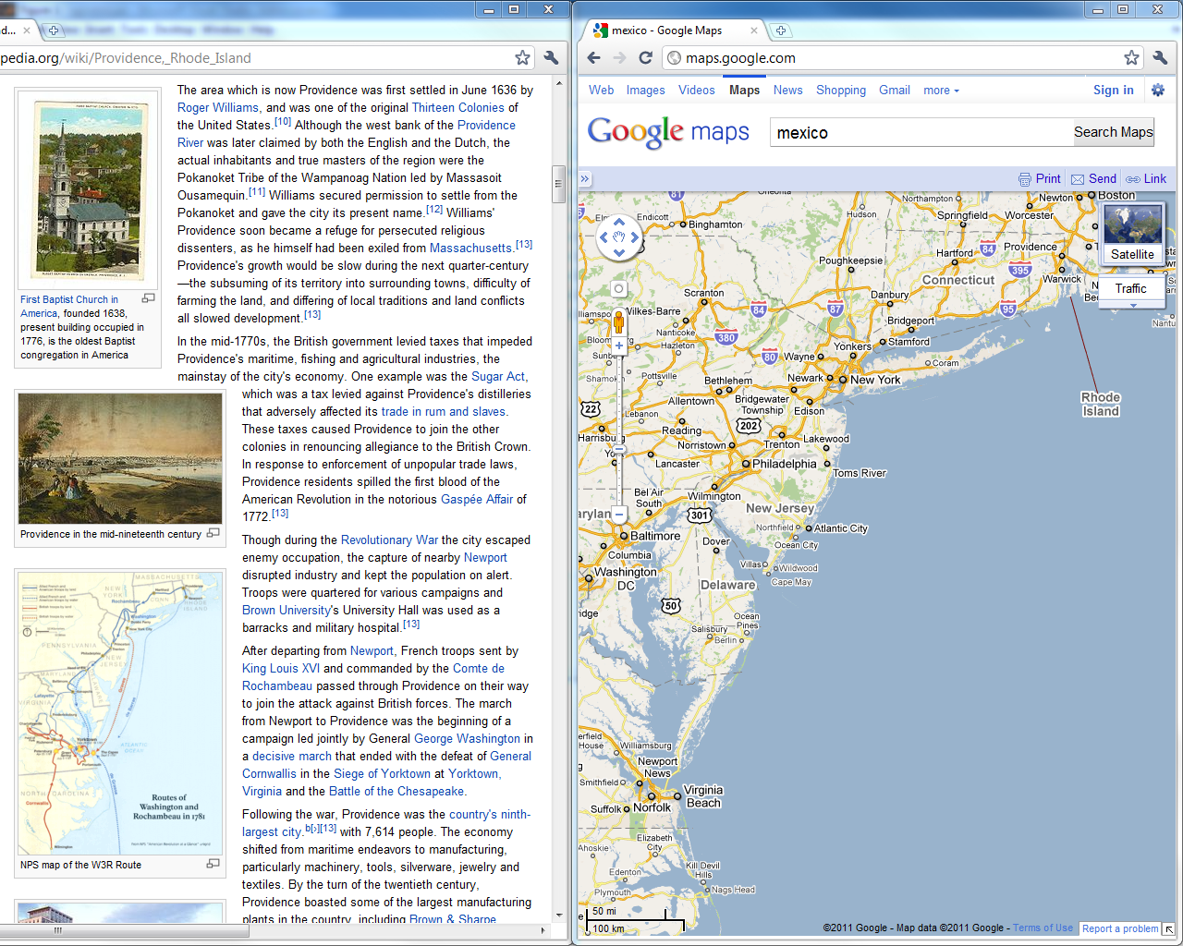
Notes:
Base representation
various highlighting techniques around

Slide 17
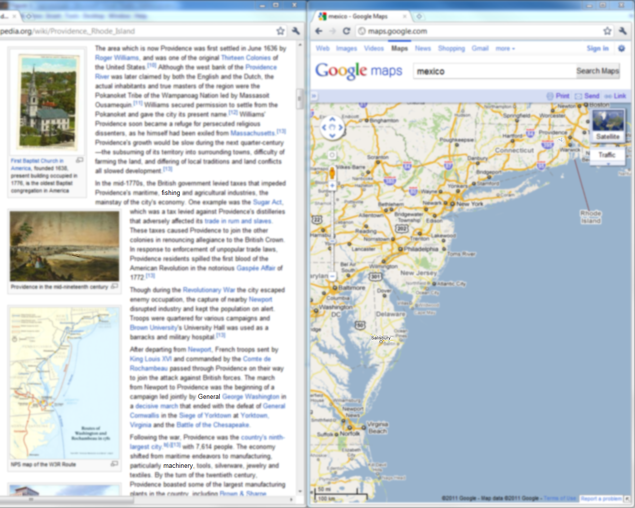
Blur Background

Slide 18
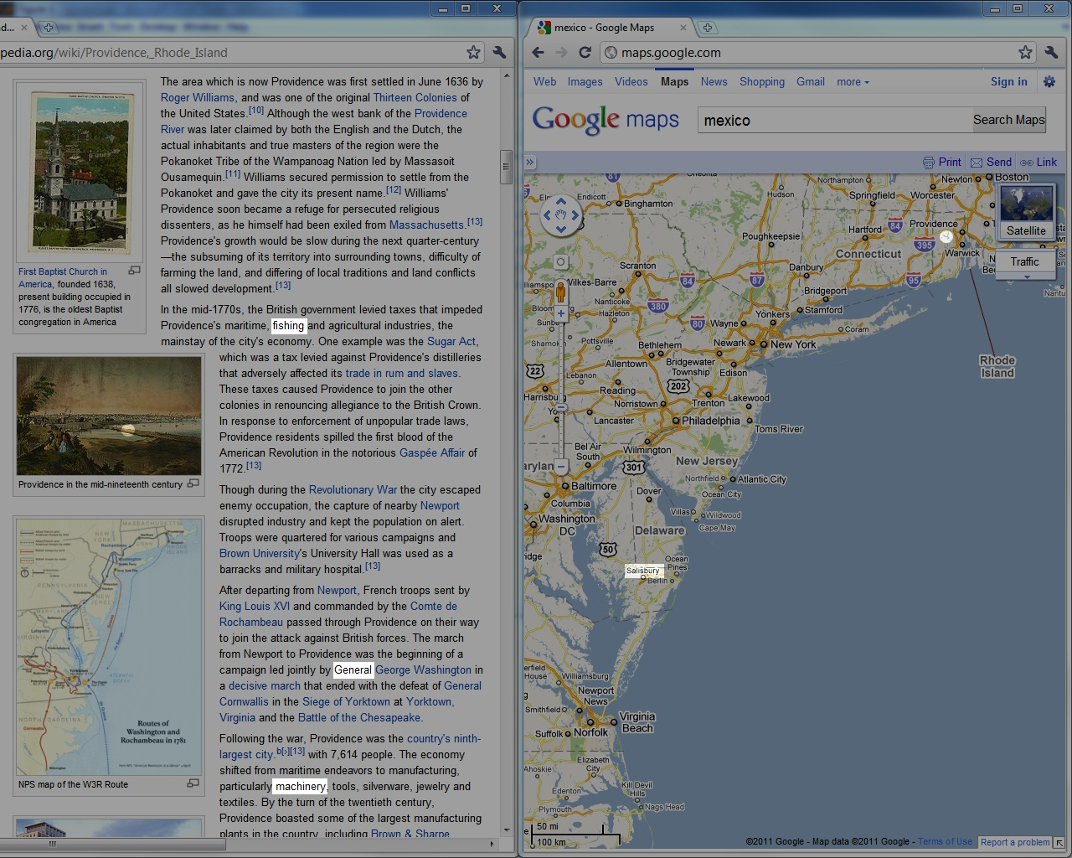
Darken Background

Slide 19
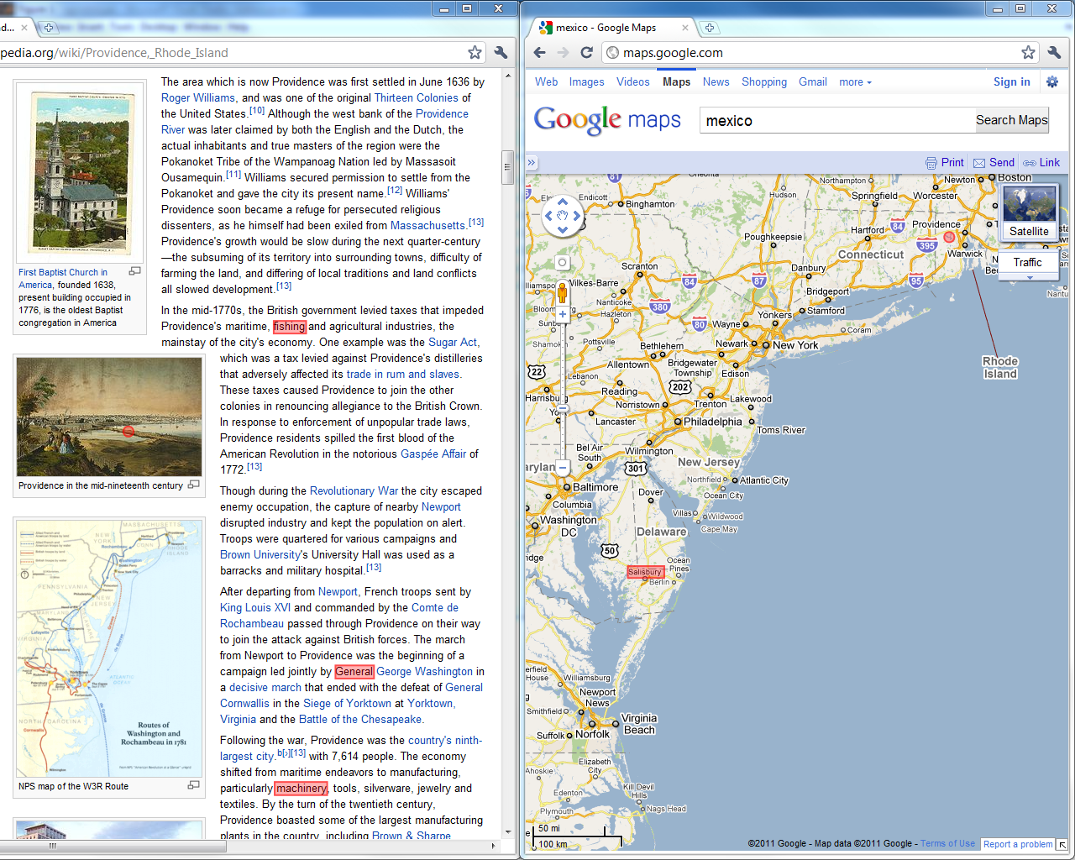
Change Color

Slide 20
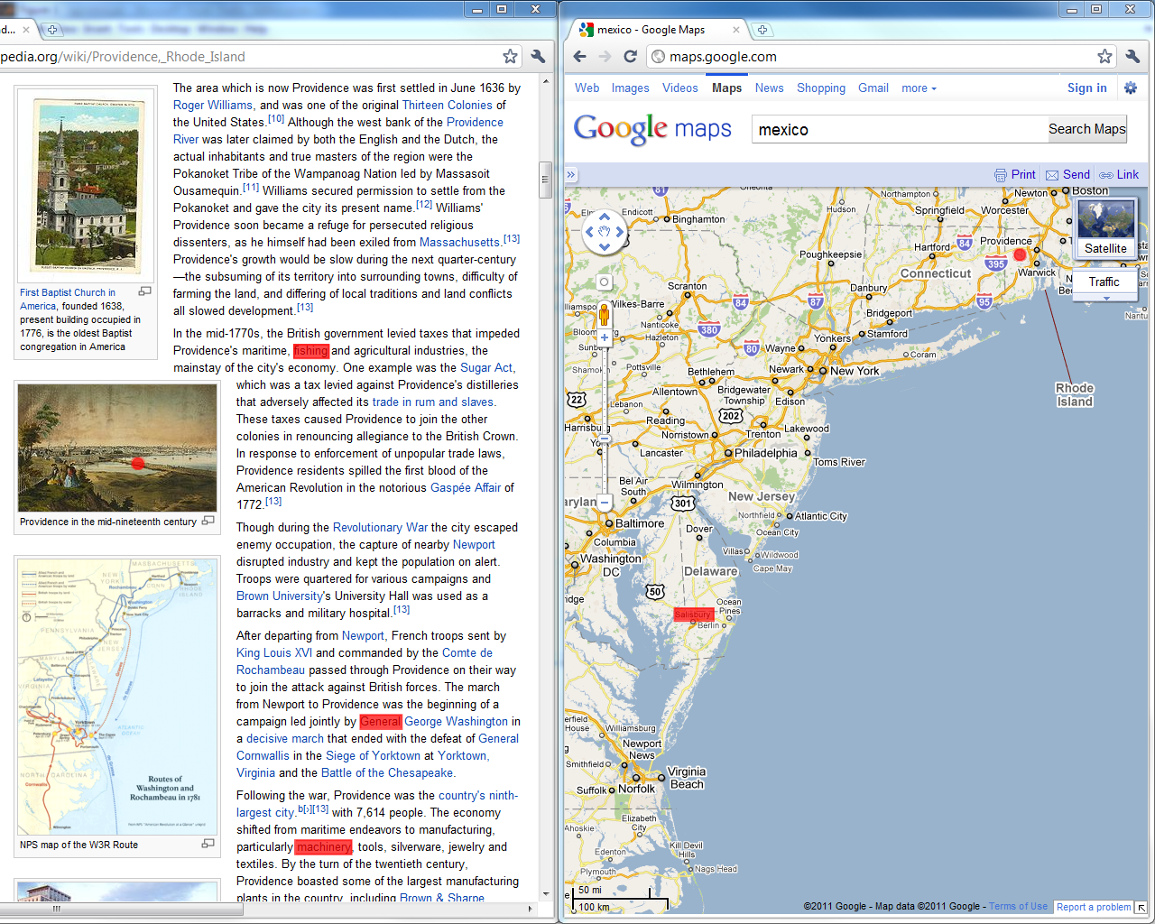
Blinking

Slide 21
Visual Linking
Notes:
Advantages for big screens (oder auch bei blinking)

Slide 22
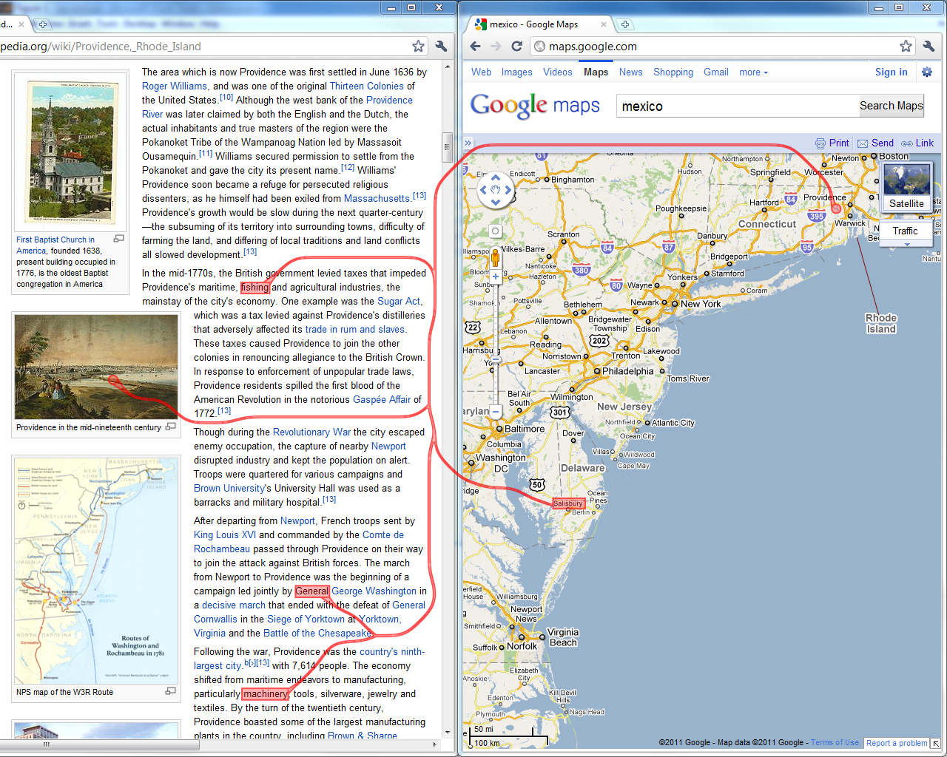
Routed Visual Linking

Slide 23
Part II: How to Link?
Similarity (Gestalt principle, Wertheimer 1923)
Proximity (Gestalt principle, Wertheimer 1923)
Connectedness (Palmer&Rock 1994)

Slide 24
About Ourselves: Alex Lex
PhD from Graz University of Technology
Post-doctoral Researcher at VCG@Harvard
Research Topics:
Visualizations with applications in molecular biology
Visual linking

Slide 25
Overview
PART 1: What to link? Defining Common Relations
PART 2: How to link?
Representing Relation on View Level
PART 3: When to link? Cases in which Linking is Beneficial

Slide 26
Part III: When to link?
Display 1
Display 2
Application 1
Application 2
Application 3
View 1
View 2
View 3
View 4
User 1
User 2
User 3

Slide 27
About Ourselves: Marc Streit
PhD from Graz University of Technology
Assistant Professor at Johannes Kepler University Linz
Visiting Researcher at Harvard Medical School
Research Topics:
Visual Analysis of Heterogeneous Data Focus: Biomolecular Data
Visual Linking
Caleydo (www.caleydo.org)

Slide 28
Overview
PART 1: What to link? Relations on Data, View, and Interaction Level
PART 2: How to link?
Representing Relation on View Level
PART 3: When to link? Application Areas that Benefit from Linking

Slide 29
Schedule
2:15 – 3:15 Part I: What to Link?
3:15 – 3:40 Part II: How to Link?
3:40 – 4:15 Coffe break
4:15 – 4:50 Part II: How to Link?
4:50 – 5:50 Part III: When to link?

Slide 30
What‘s your background?
Notes:
FEEL FREE TO INTERRUPT US AND ASK QUESTIONS

Slide 31
What‘s Next: What to Link by HANSI

